Slide 1
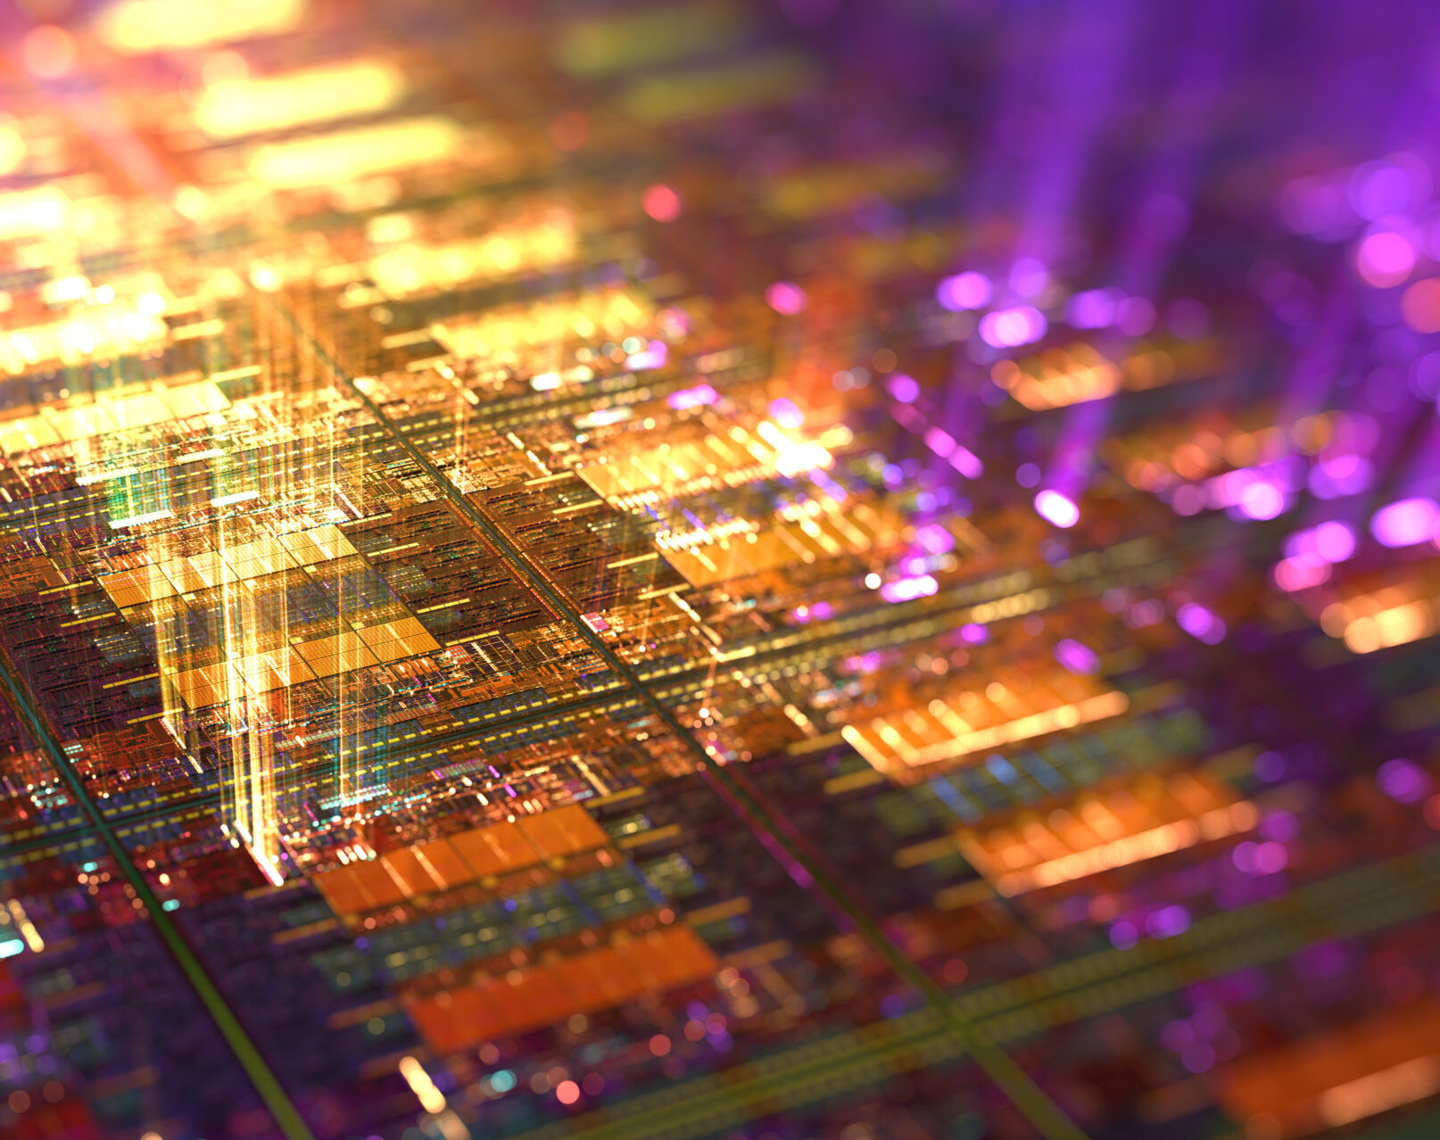
The geopolitics of microchips
Marc von Gehlen
BKFH
Notes:
Hello and welcome to my presentation
Today I present to you...

Slide 2
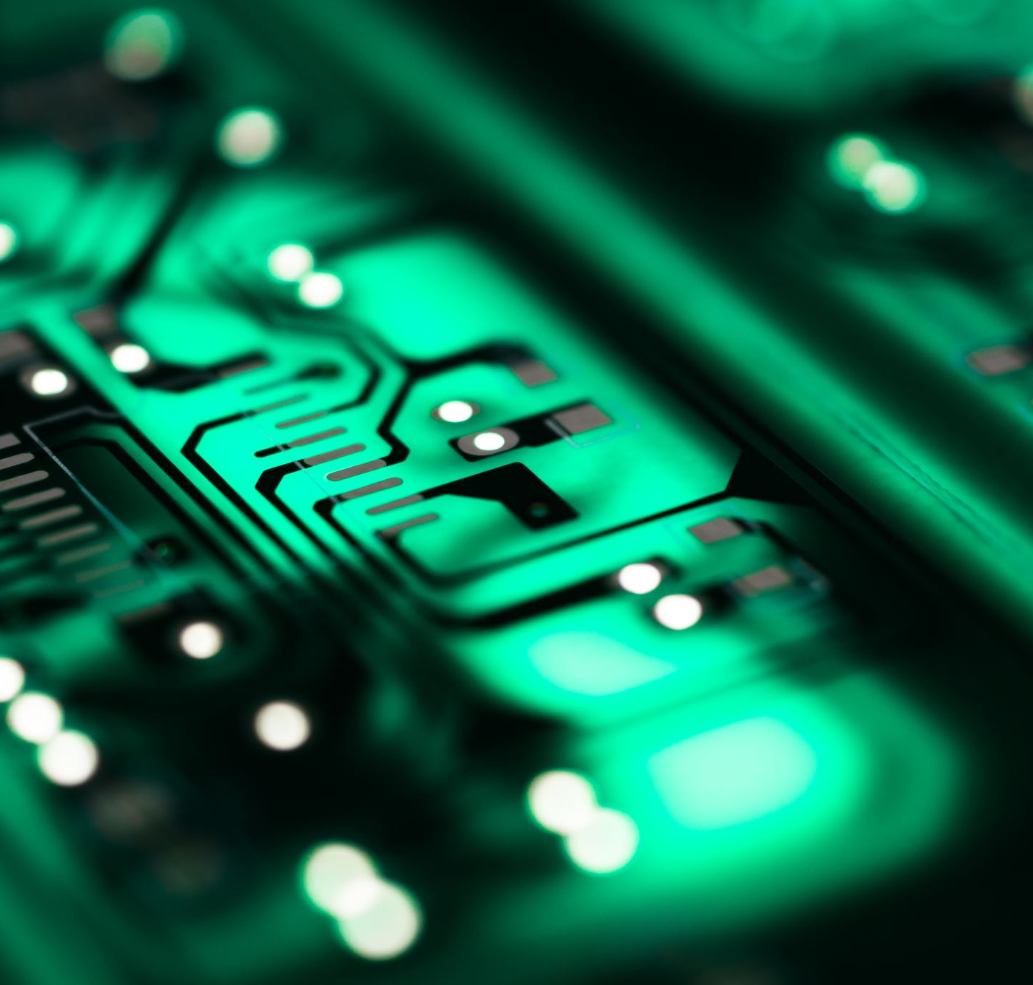
Structure
Microchips
Where are chips located?
Where are they produced?
Factories Supply chain
Market dependency
China-Taiwan relationship
Taiwan Relations Act
Current situation
Germany's stance
Notes:
Today I am talking about
I introduce you
I come to the topic

Slide 3
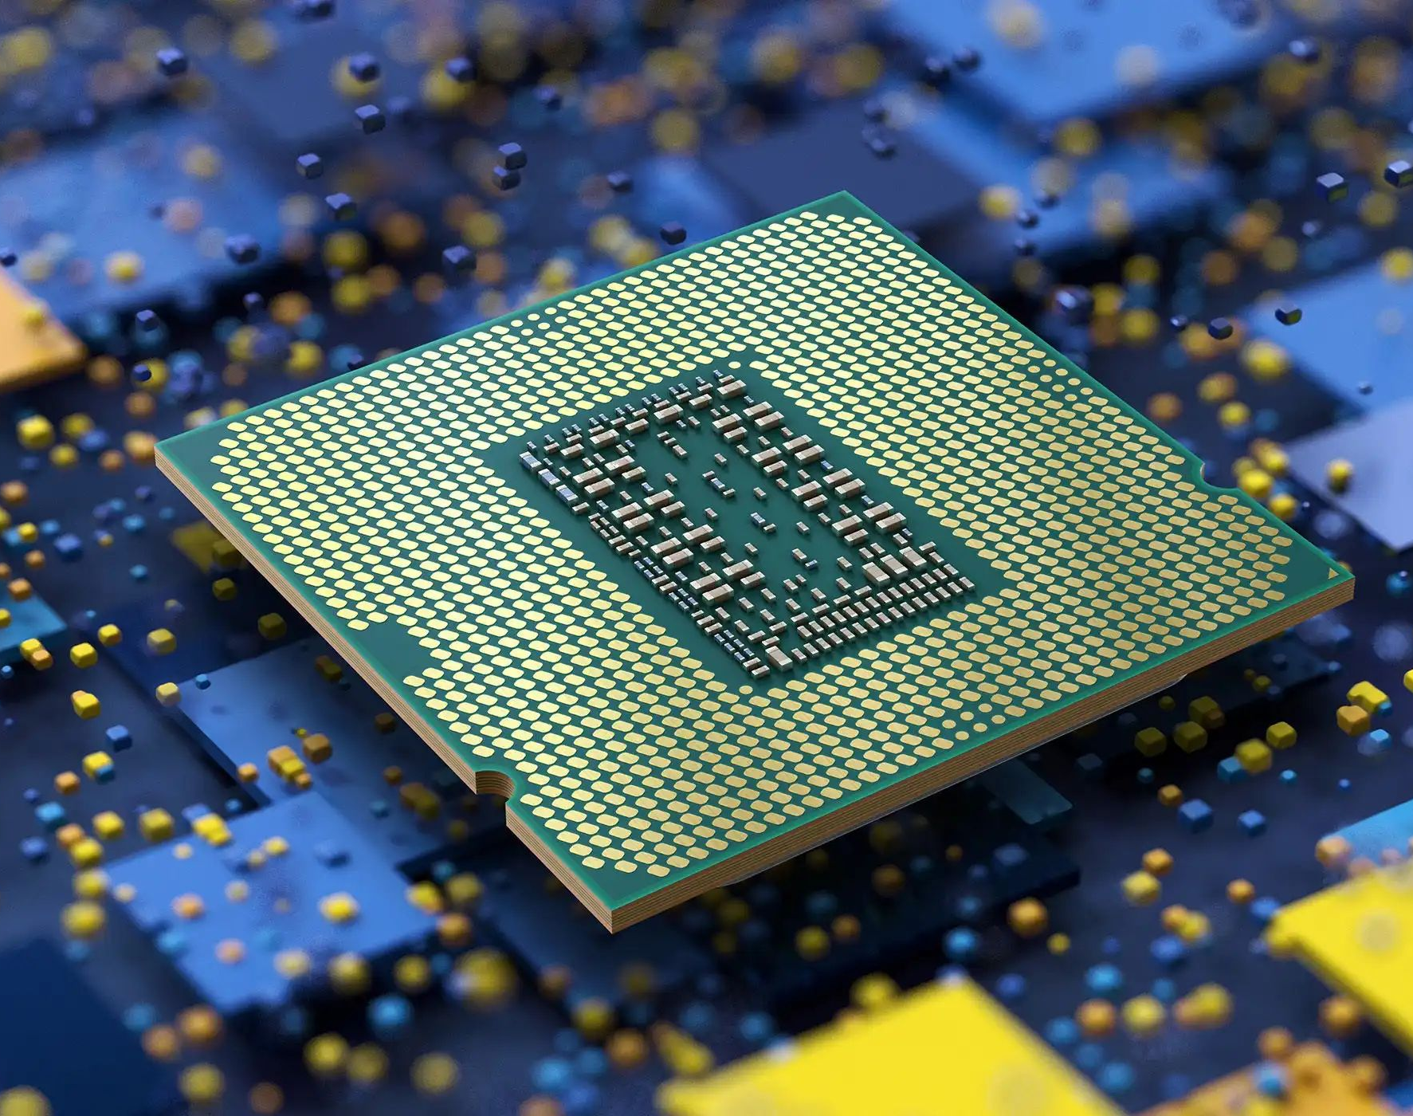
Microchips
What are microchips?
What do microchips look like?
Meaning & function of microchips
Notes:
- Electronic circuits / logic components which sit on silicon, a so-called "semiconductor", small switches 1 and 0

Slide 4
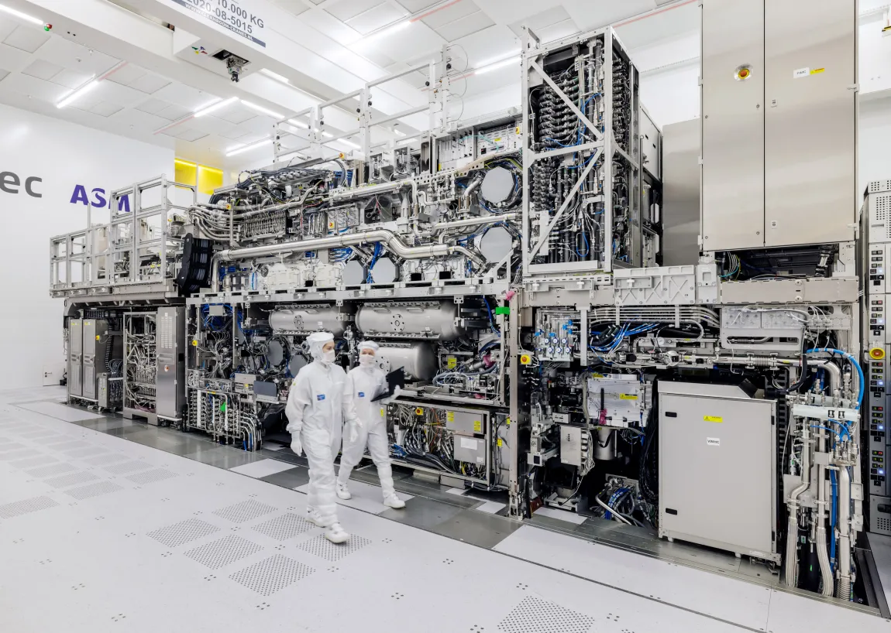
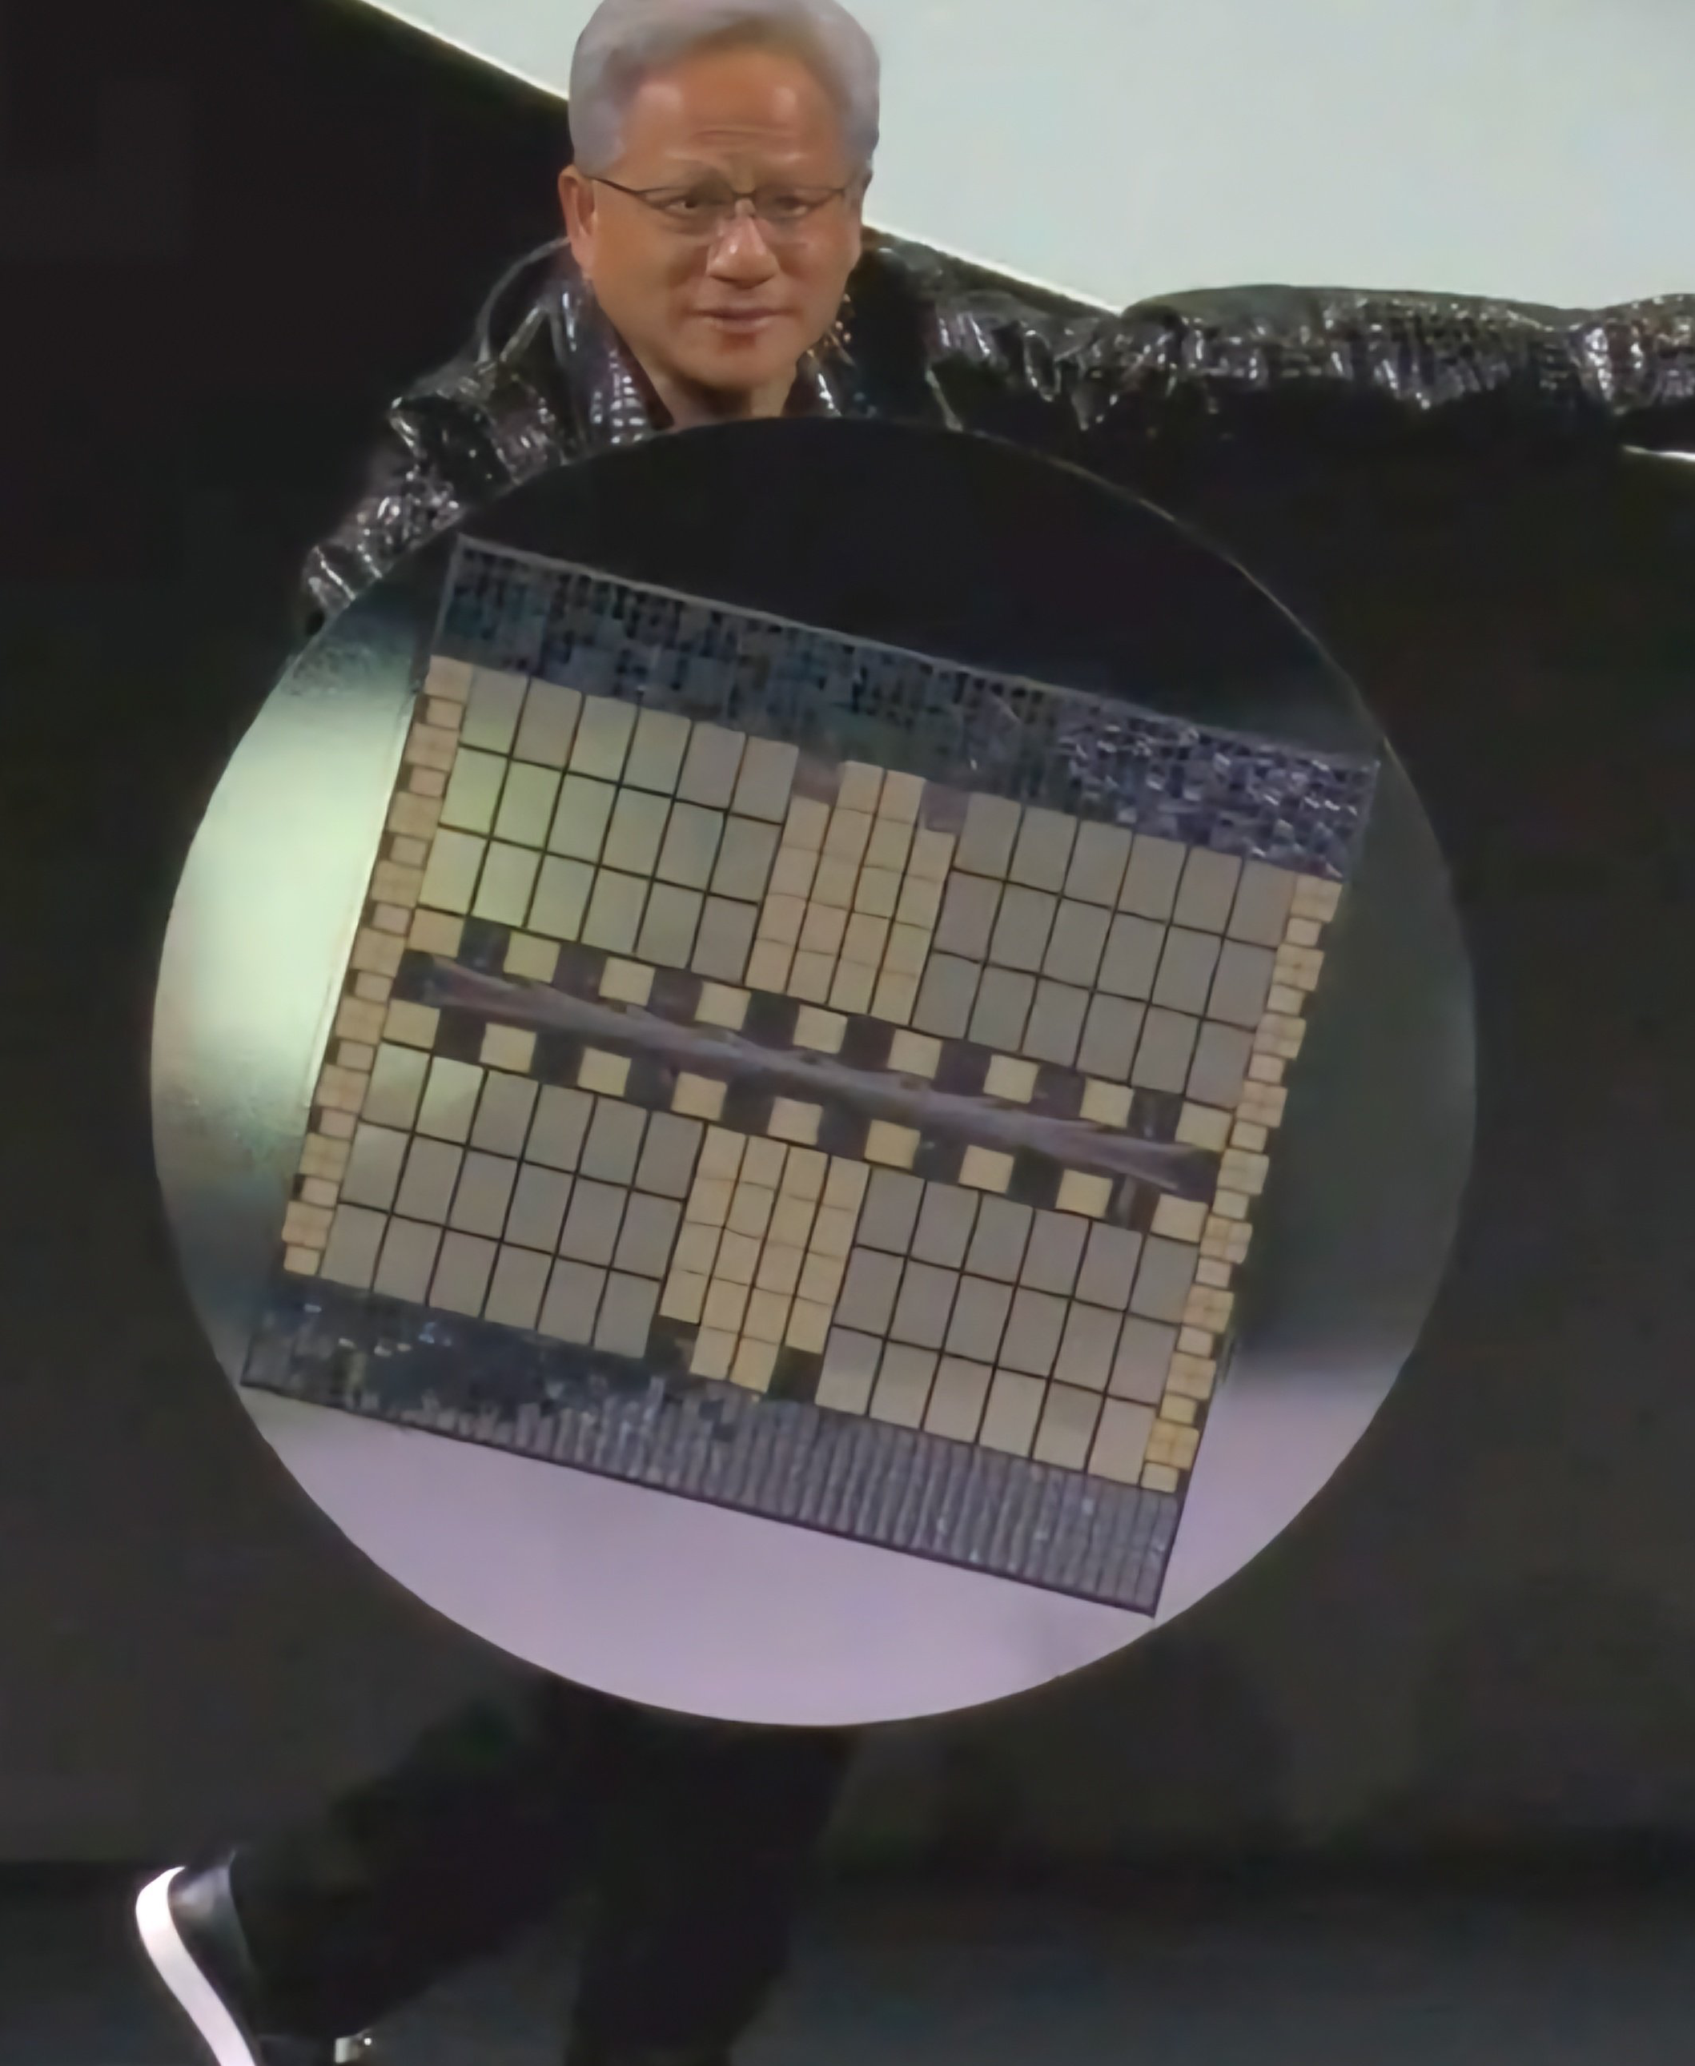
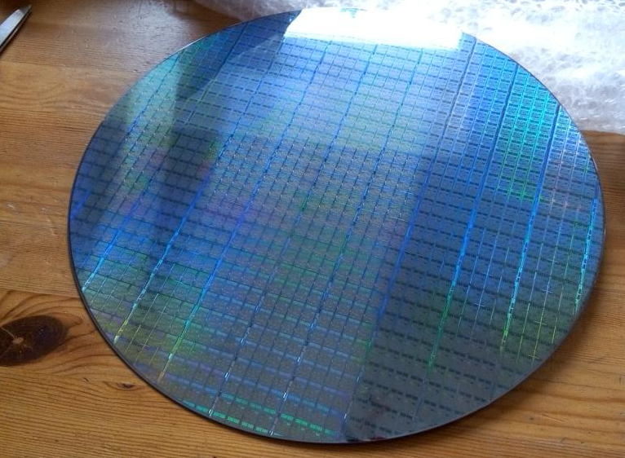
Notes:
ASML Lithography maschines 300 Mio / per
Waver Are Produced
Jenson Huang with a waver

Slide 5
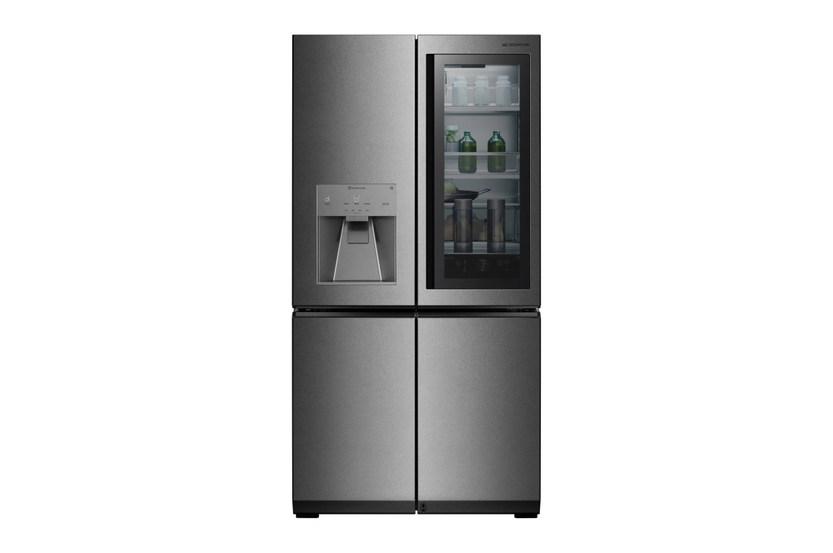
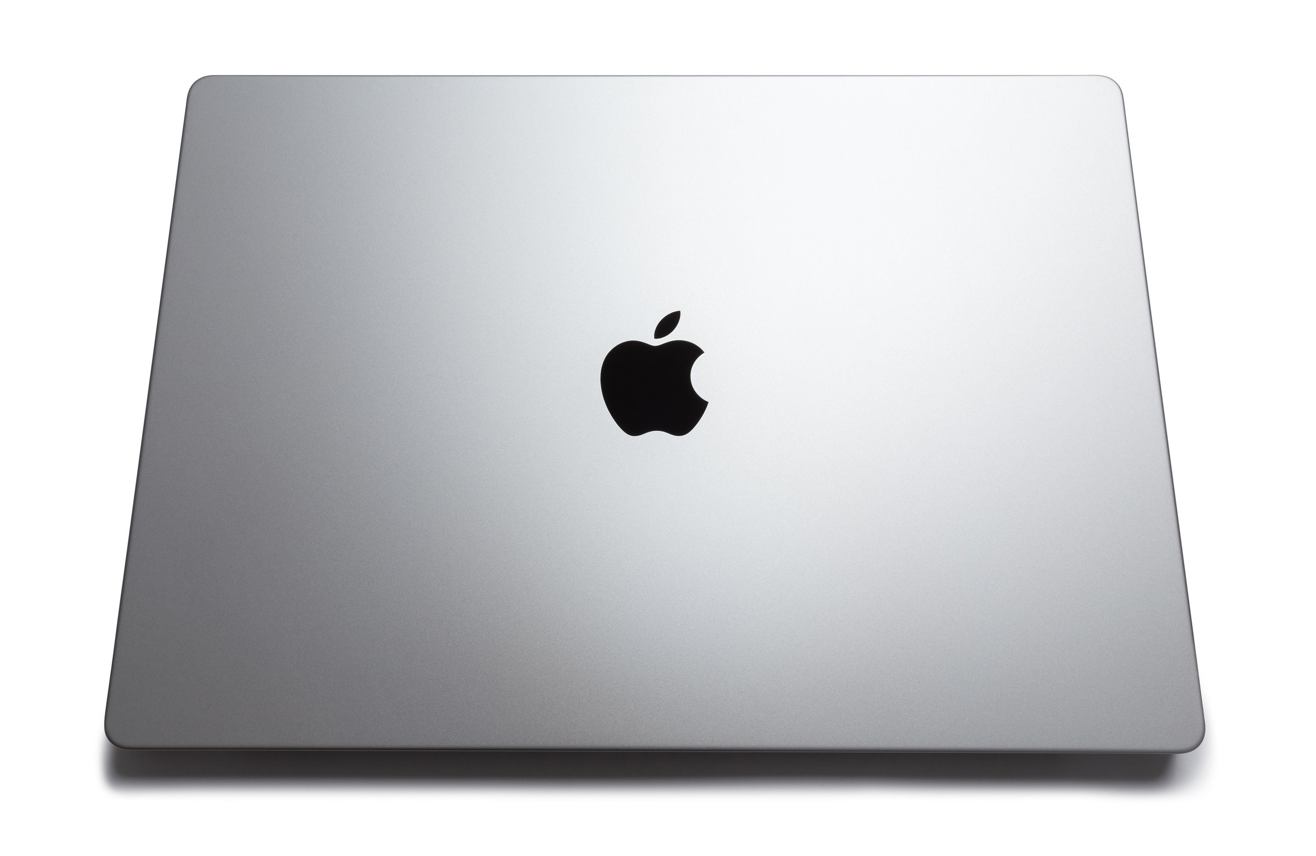
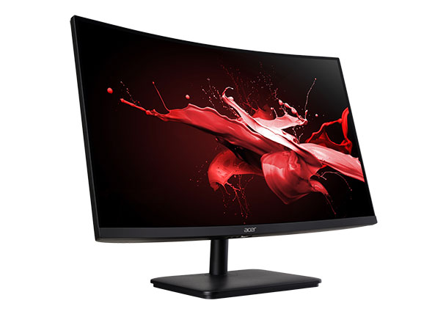
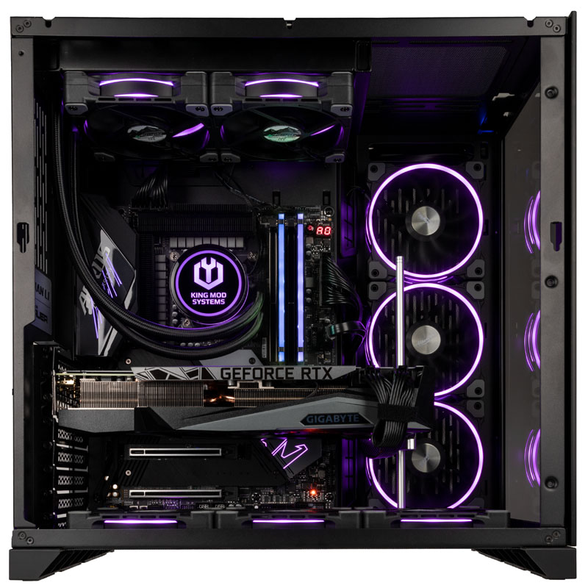
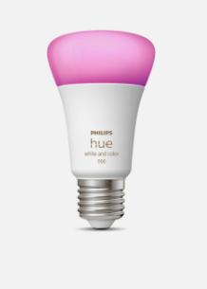
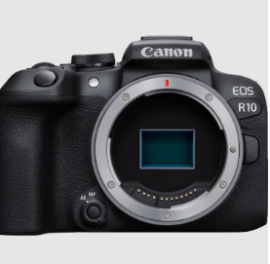
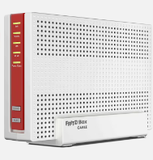
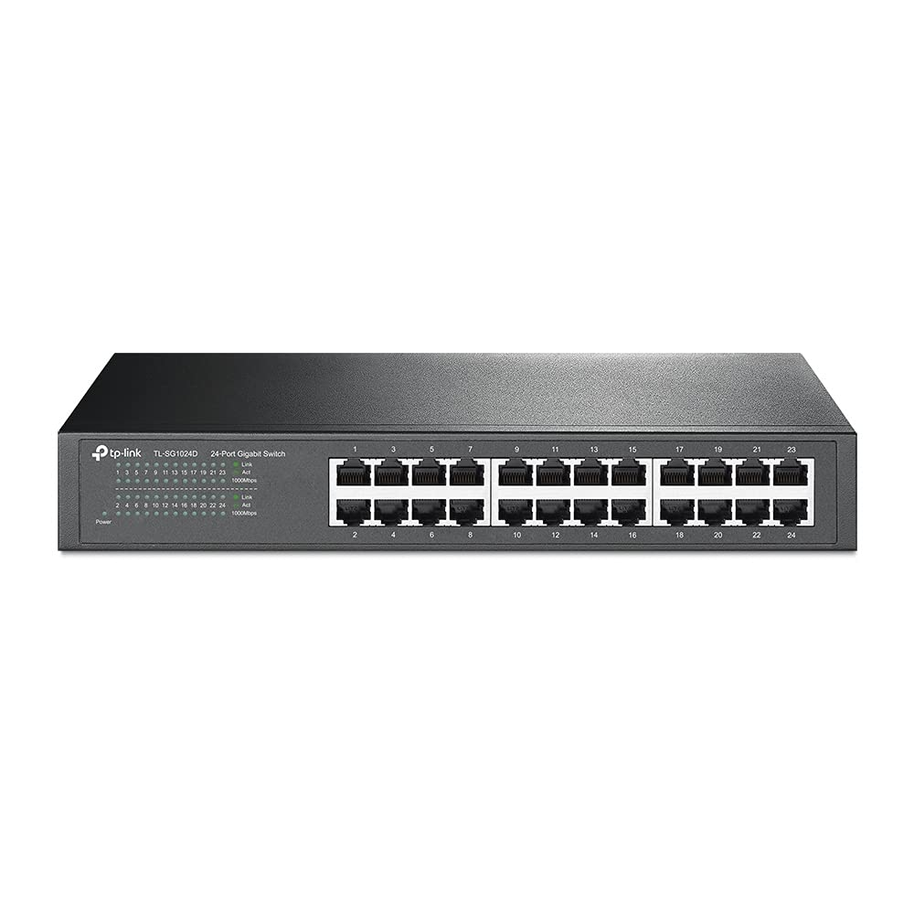

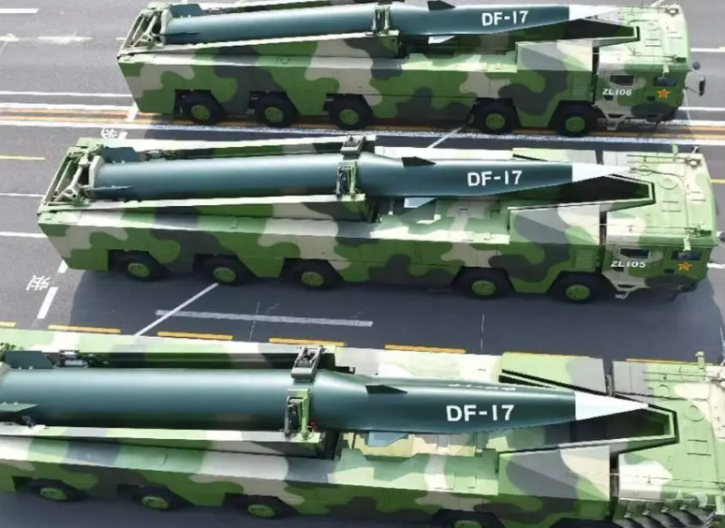
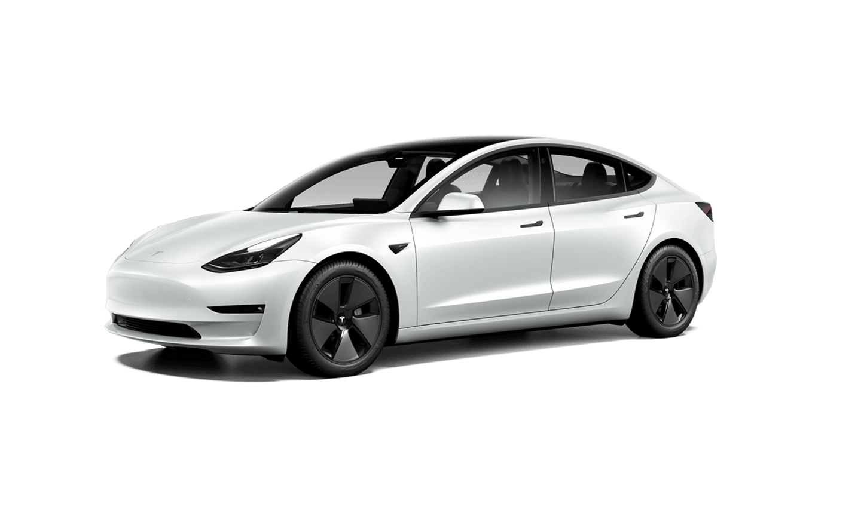
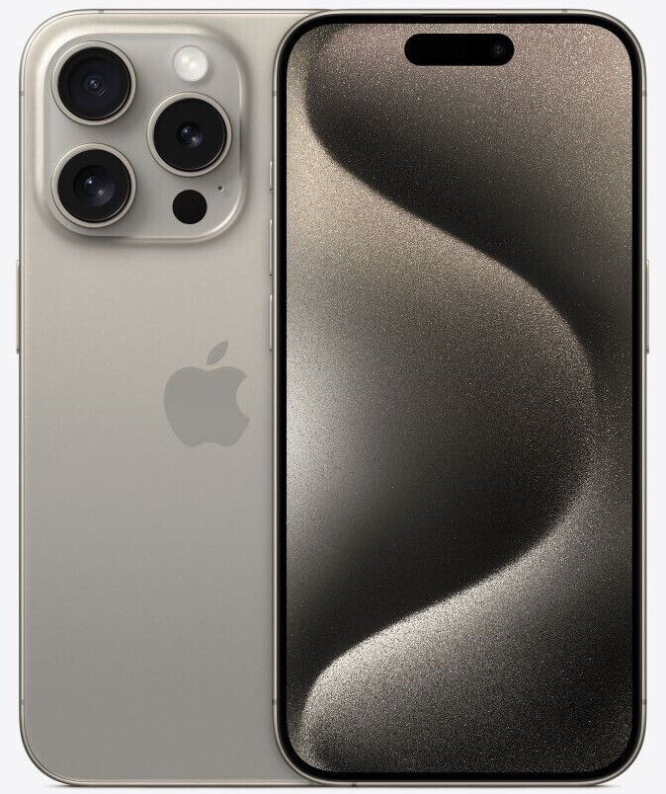
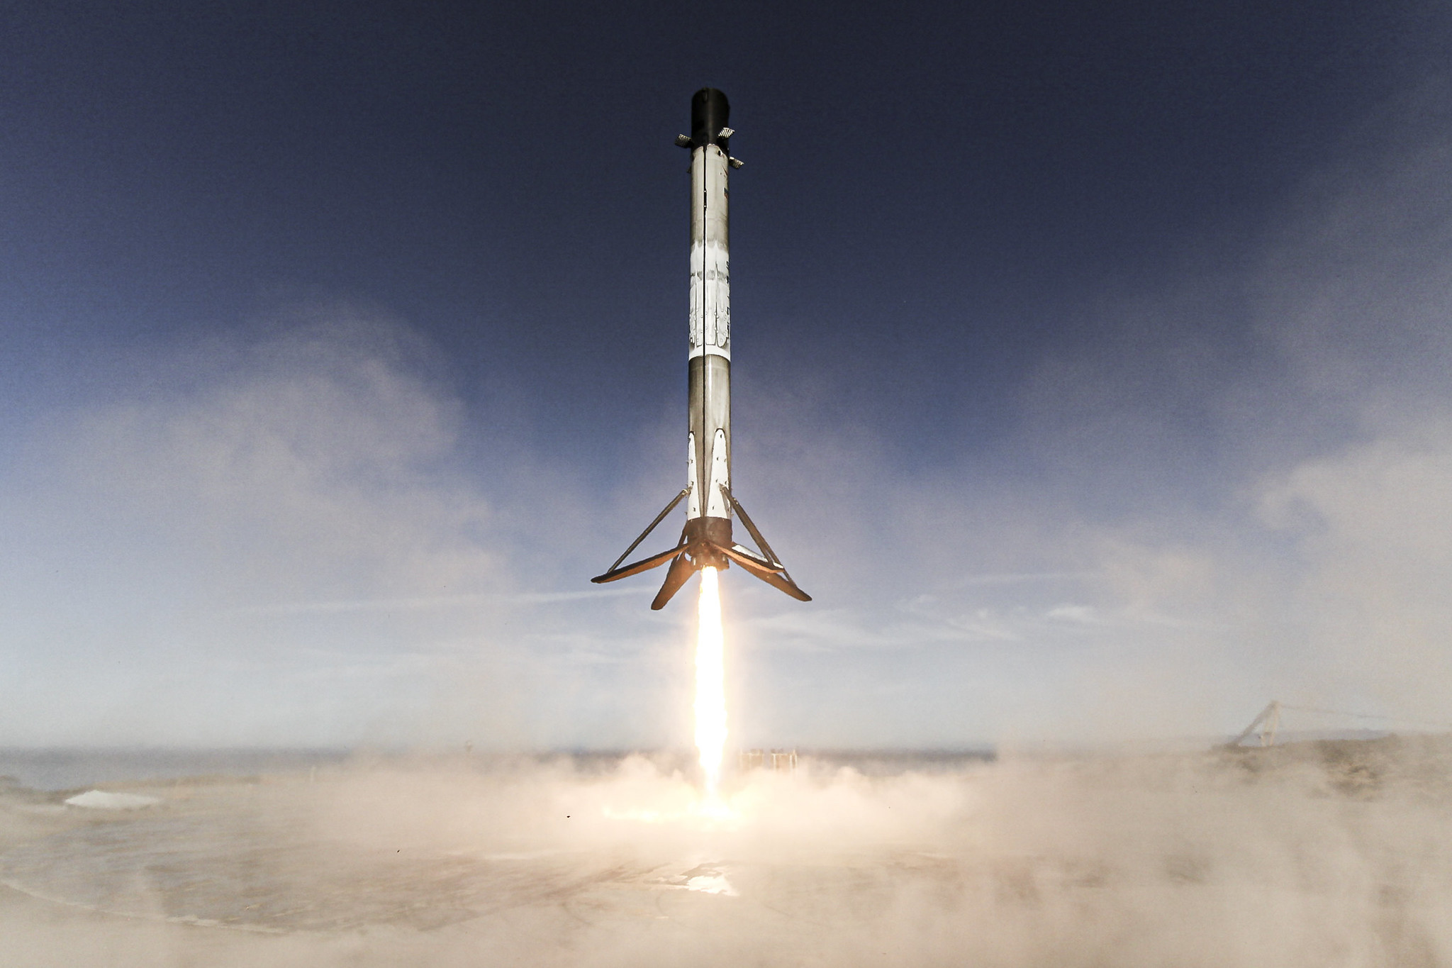
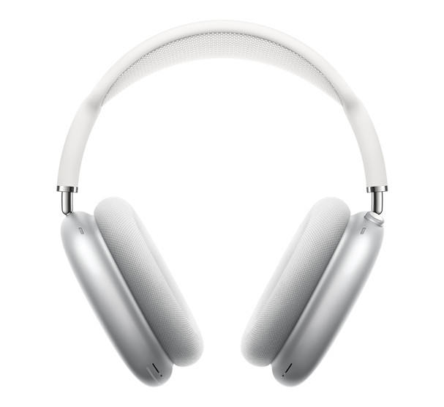
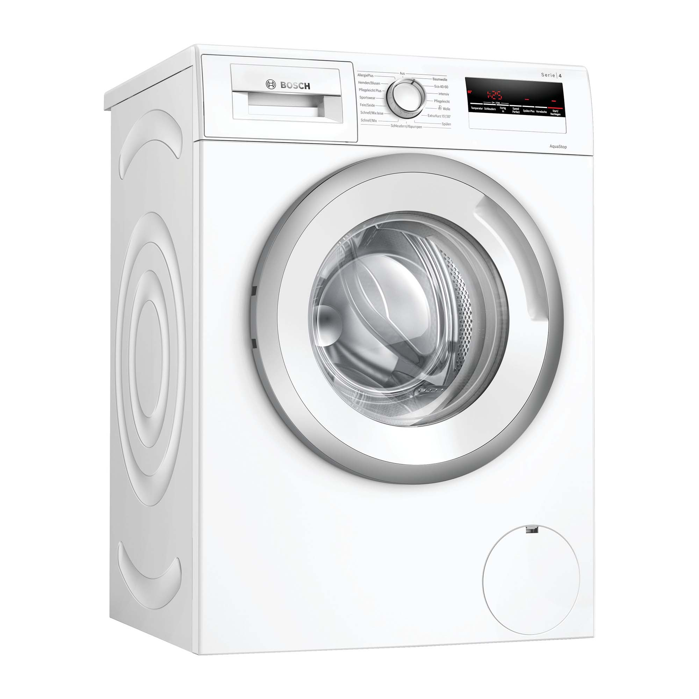
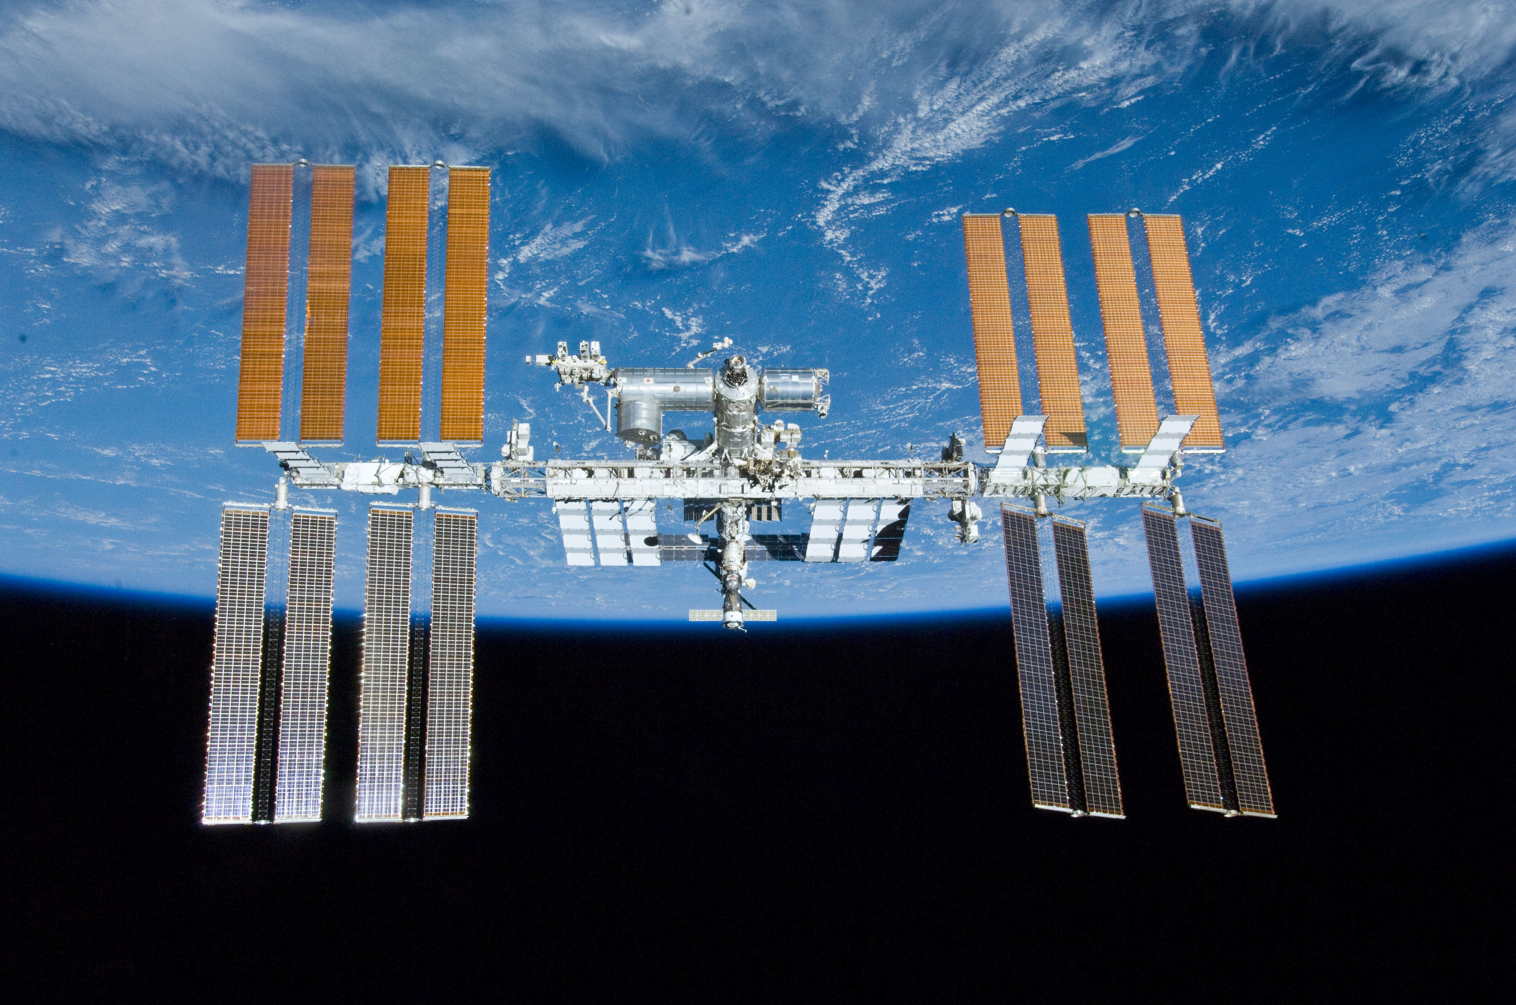
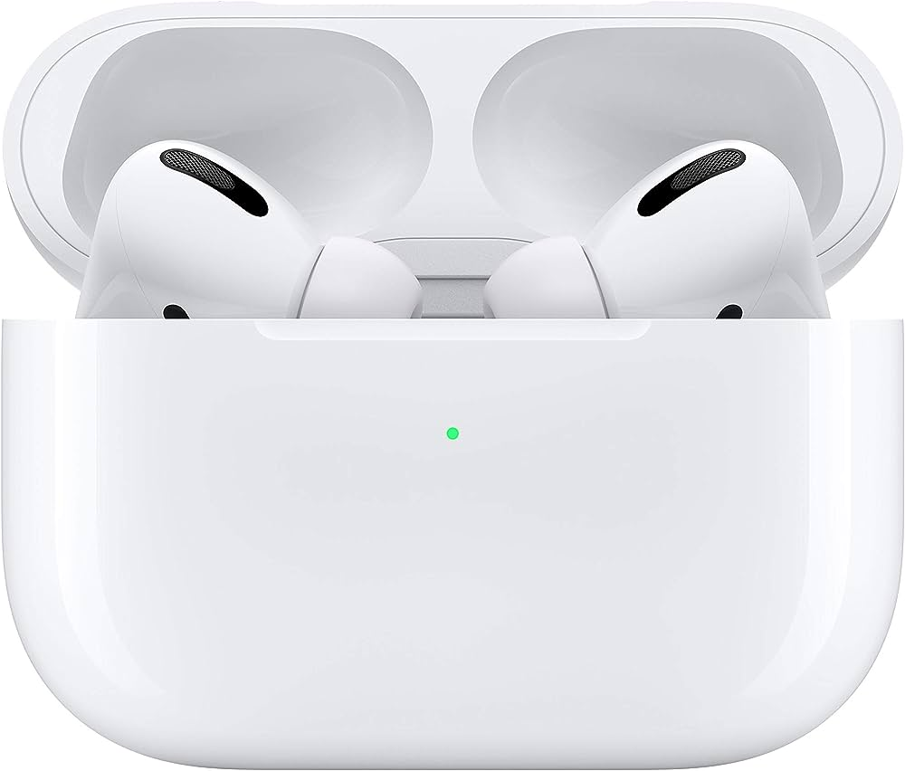
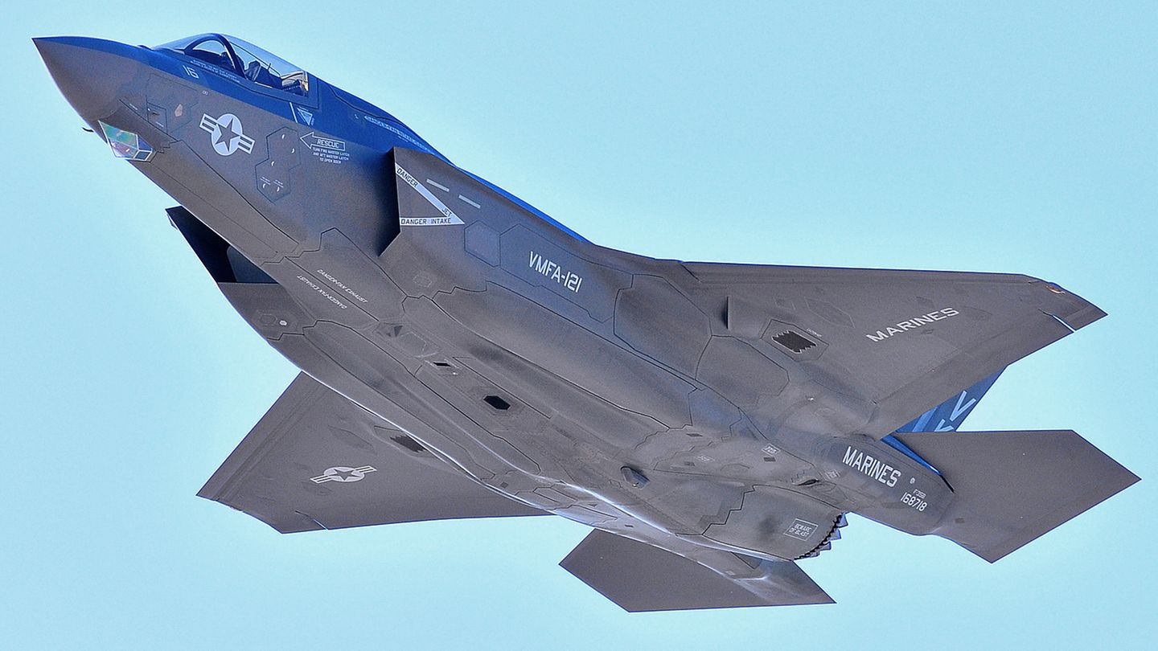
Microchips = economic / political power
Notes:
- Technical equipment / Military equipment / Space travel / Cars- Chips = economic power - Entire modern economy is dependent on it- Chip crisis (what happens if they are missing)

Slide 6
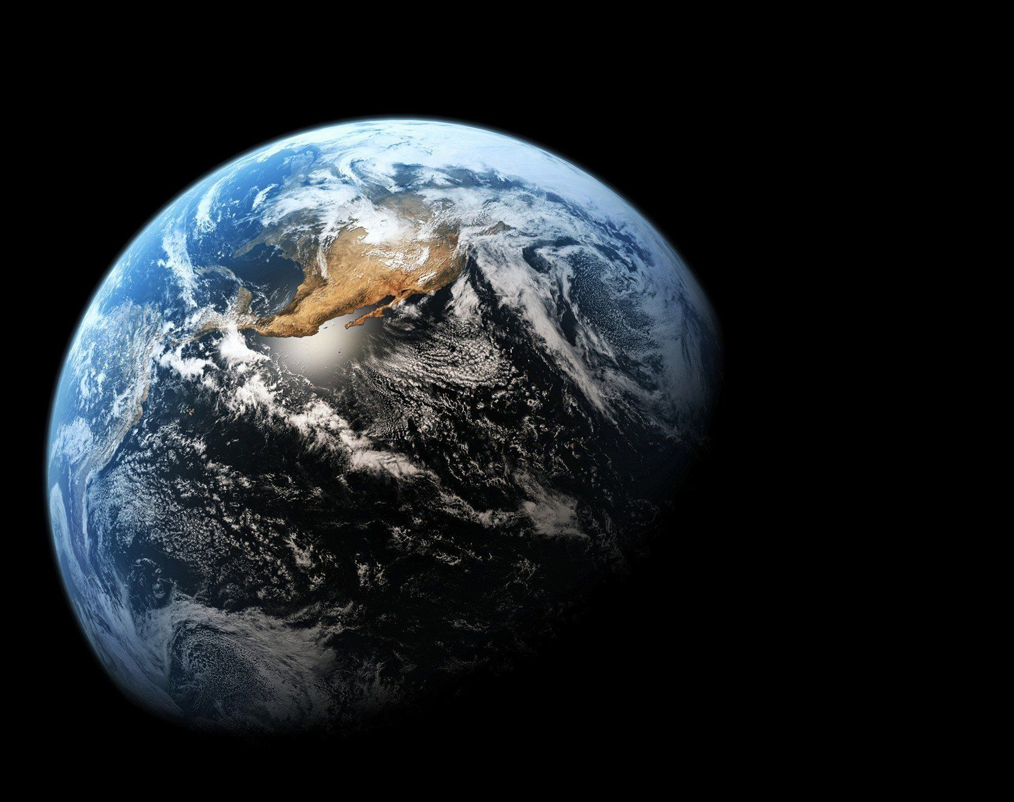
Where are microchips (mainly) produced?
Notes:
Where in the world are microchips mainly produced?

Slide 7
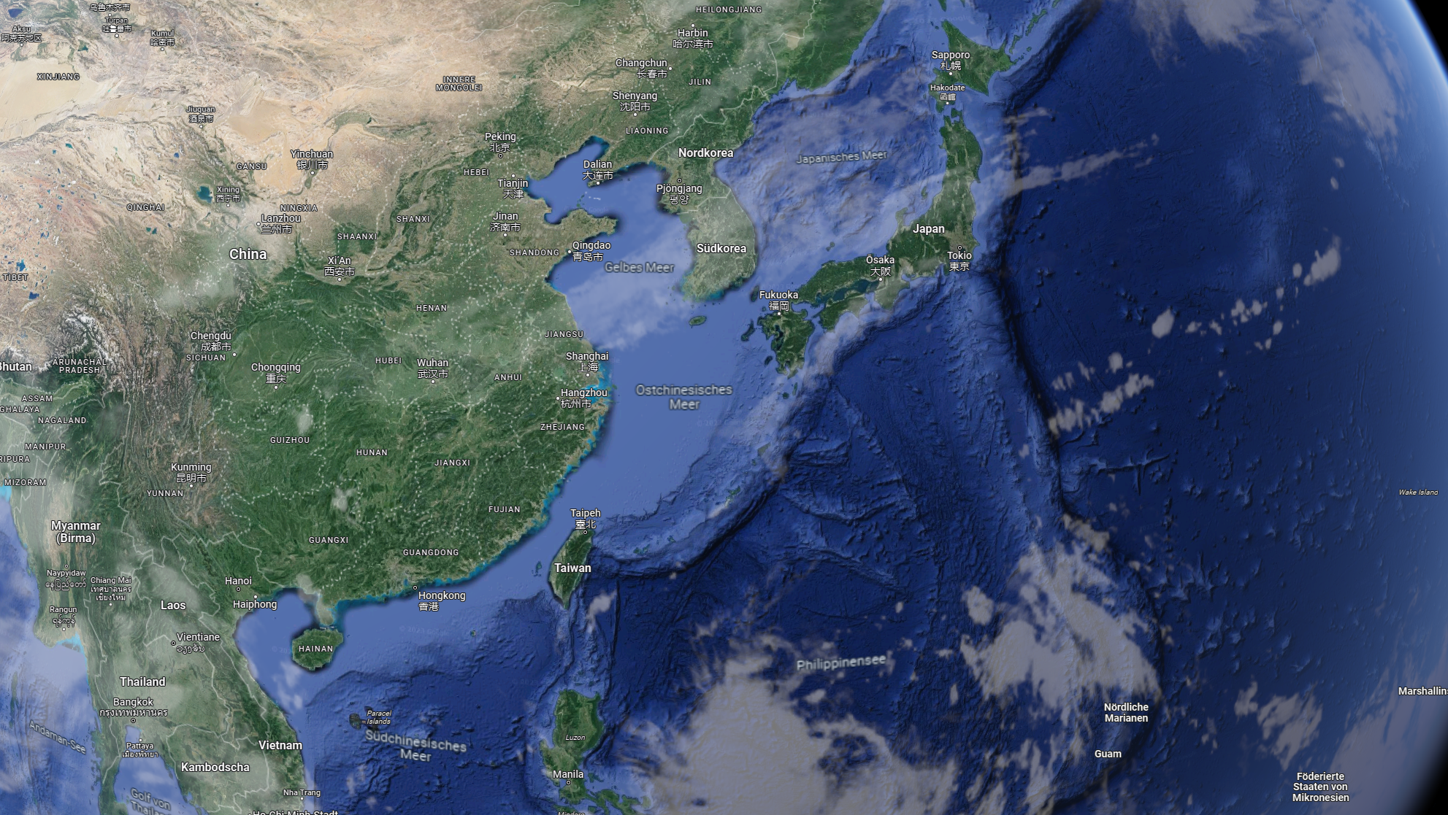
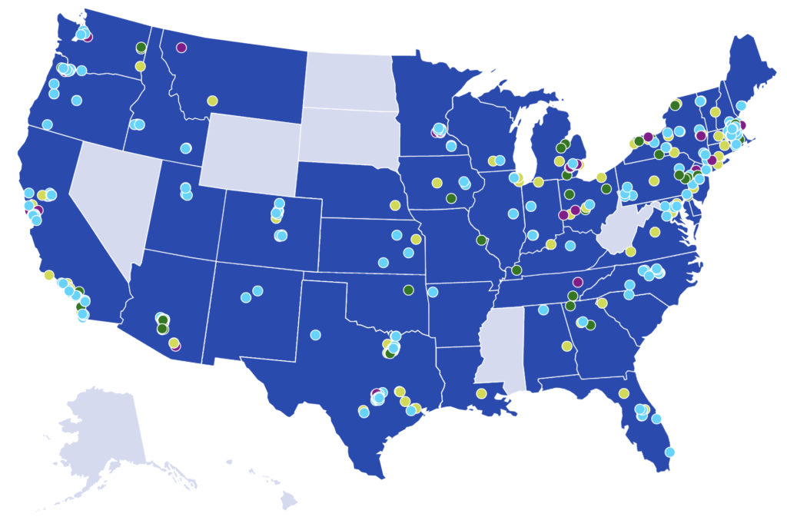
Notes:
South Korea
Taiwan (See how close Taiwan is to China)
USA but still in construction, coming back later to it

Slide 8
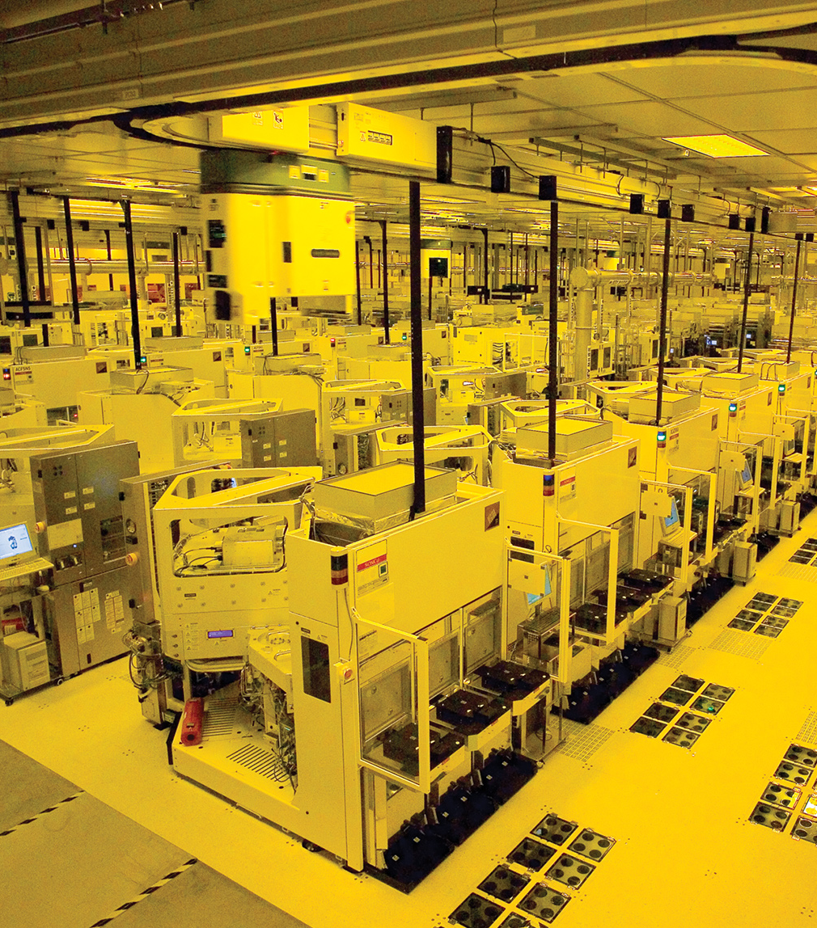
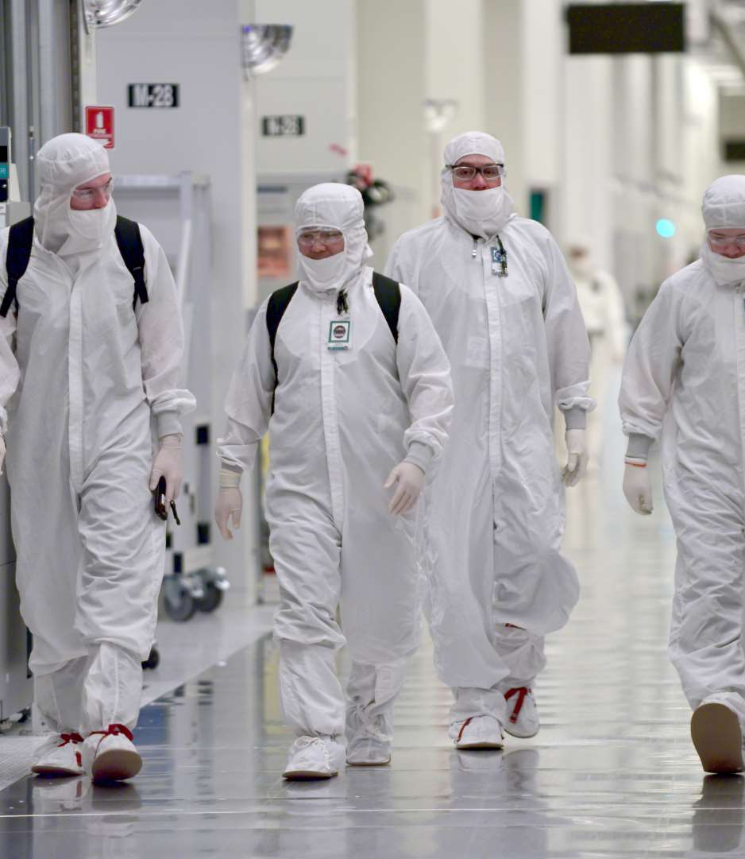
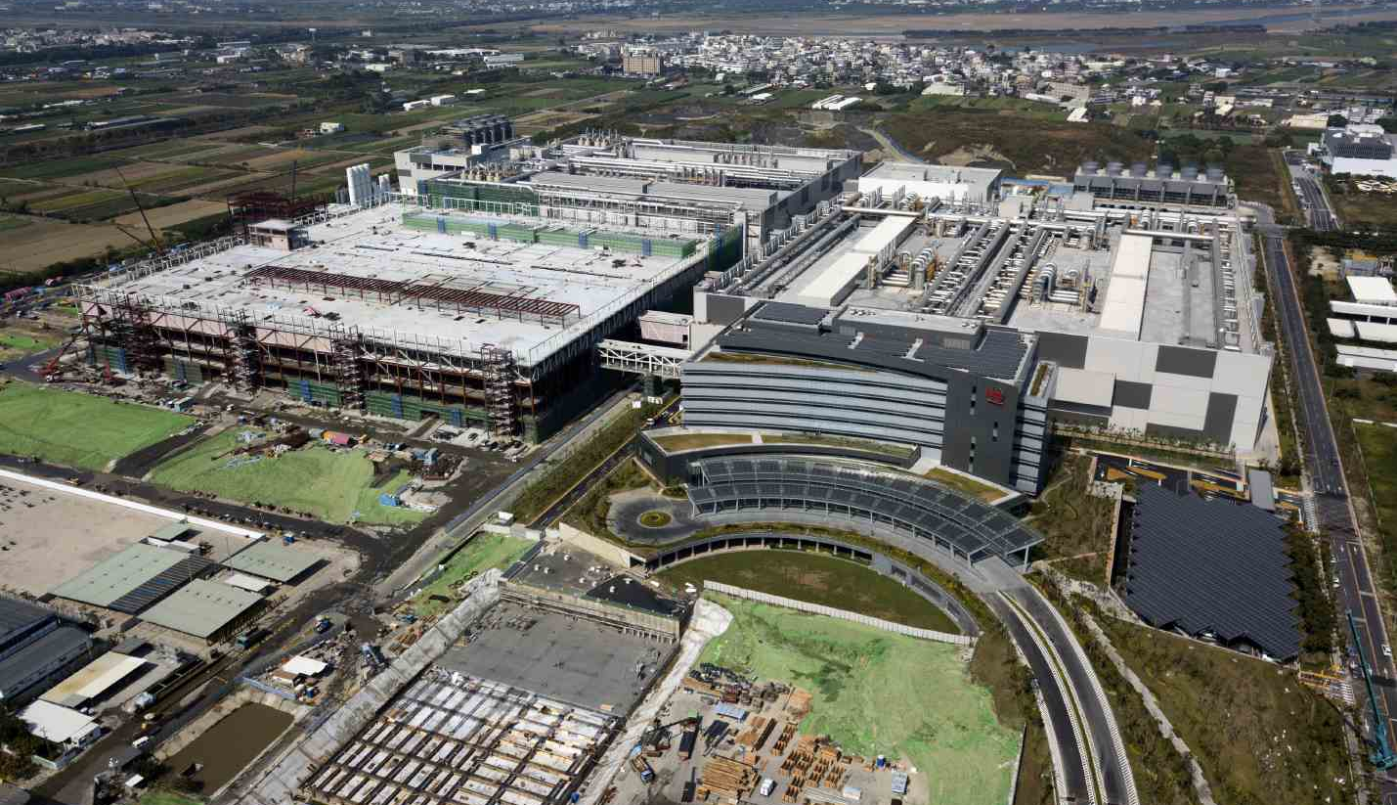
Factories (FABS)
7 – 50 Milliarden $ / FAB
Only large companies can participate
Big barrier to entery
Notes:
Factories Super Expensive
Only large companies can participate
Hard to catch up
The Chinese government also wants to change this
China and Russia have their own producers but are about 10 years behind

Slide 9
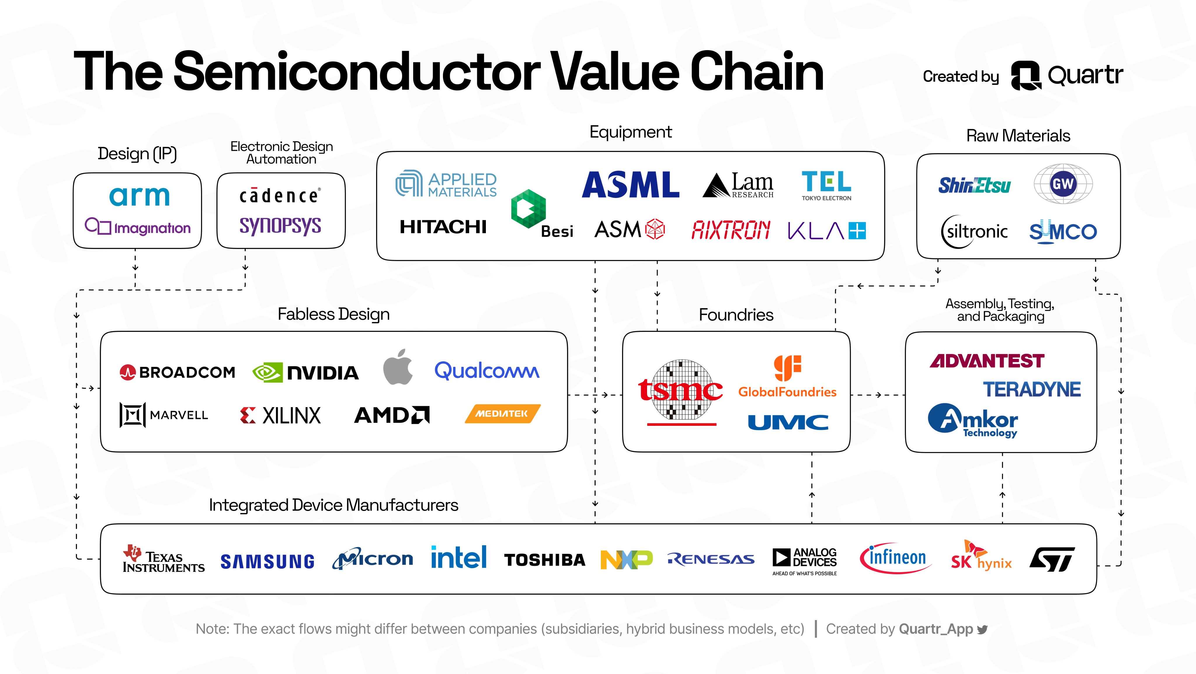
Notes:
Value Chain
Foundaries are the bottle neck

Slide 10

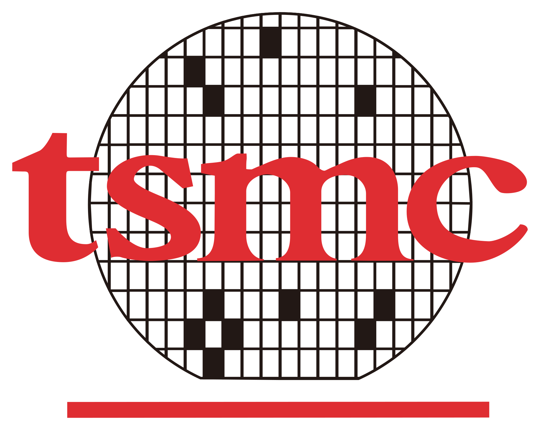
Market share
Notes:
Dependence on TSMC and Samsung for the best chips
High geopolitical risk
High dependence on 2 companies

Slide 11
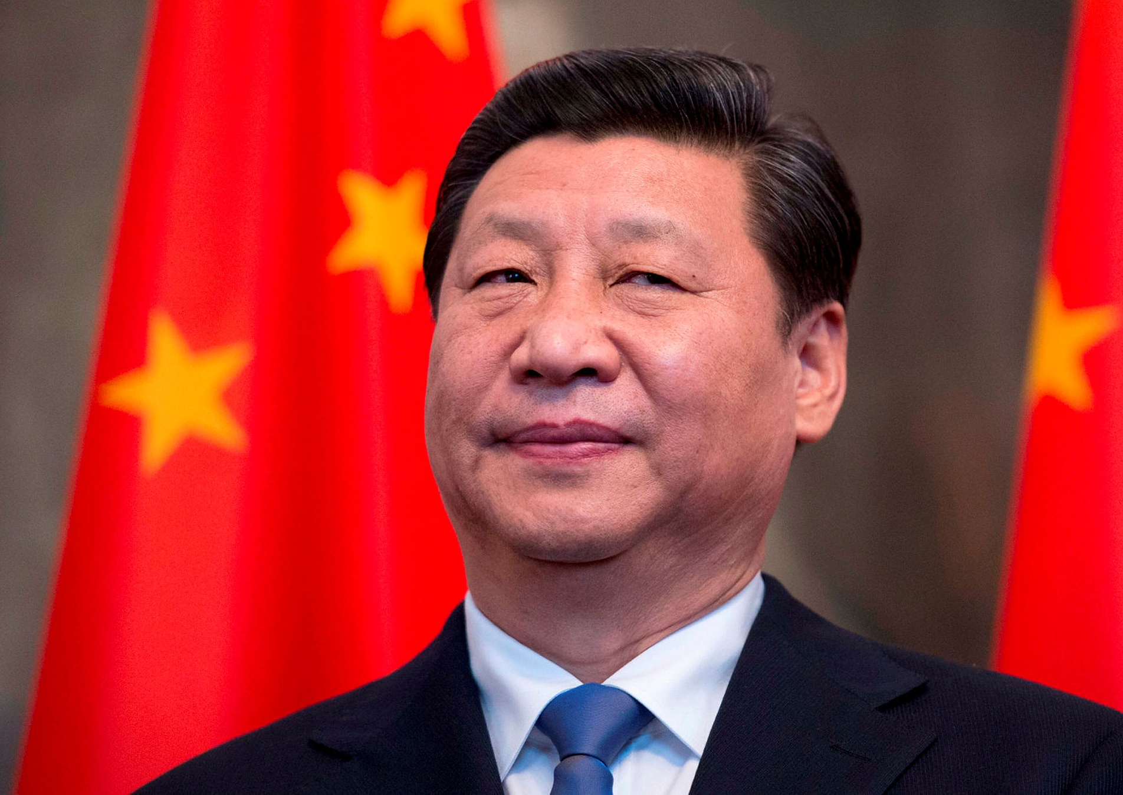
China-Taiwan relationship
- History
- „One China policy“
- Trade dependencies
- Separation movement
Xi Jinping „We will never allow any organization, or political party, at any time or in any form, to separate any part of Chinese territory from China“
Notes:
ROC: Republic of China – Taiwan. PRC: Peoples Republic of China (Communist)- China
Explaining a China Strategy (Recognition worldwide China – Taiwan
Reunification by all means by 2050
Trade Dependence (Taiwan Chips Whole World)
Independence (Indentification of Taiwan)
XI Quote

Slide 12
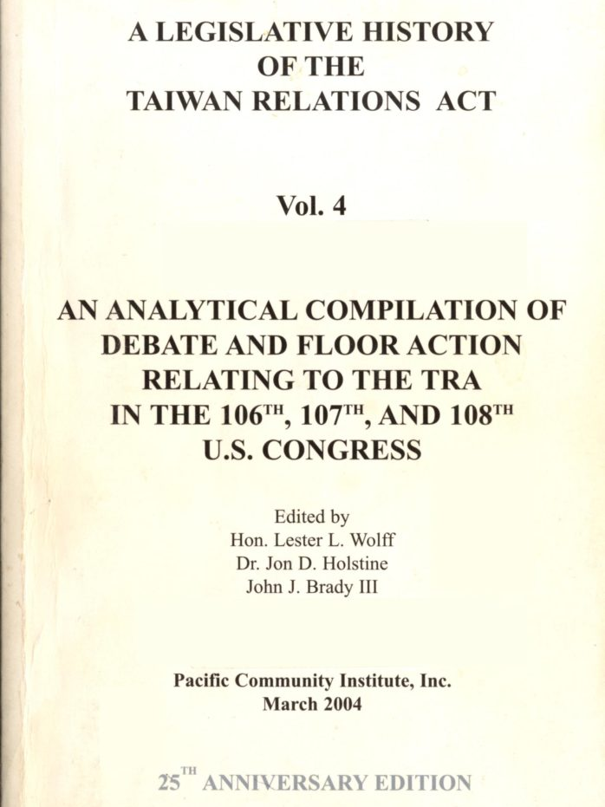
Taiwan Relations Act
Policy USA-Taiwan-China
Defence of Taiwan in a Invasion
Potential to escalate to a intercontinental war USA-China?
Notes:
Law of the USA
Relationship rules between USA-Taiwan-China
USA assures defense of Taiwan in case of invasionInvasion -> potential war between USA and China (nuclear powers) -> Trigger Article 5

Slide 13
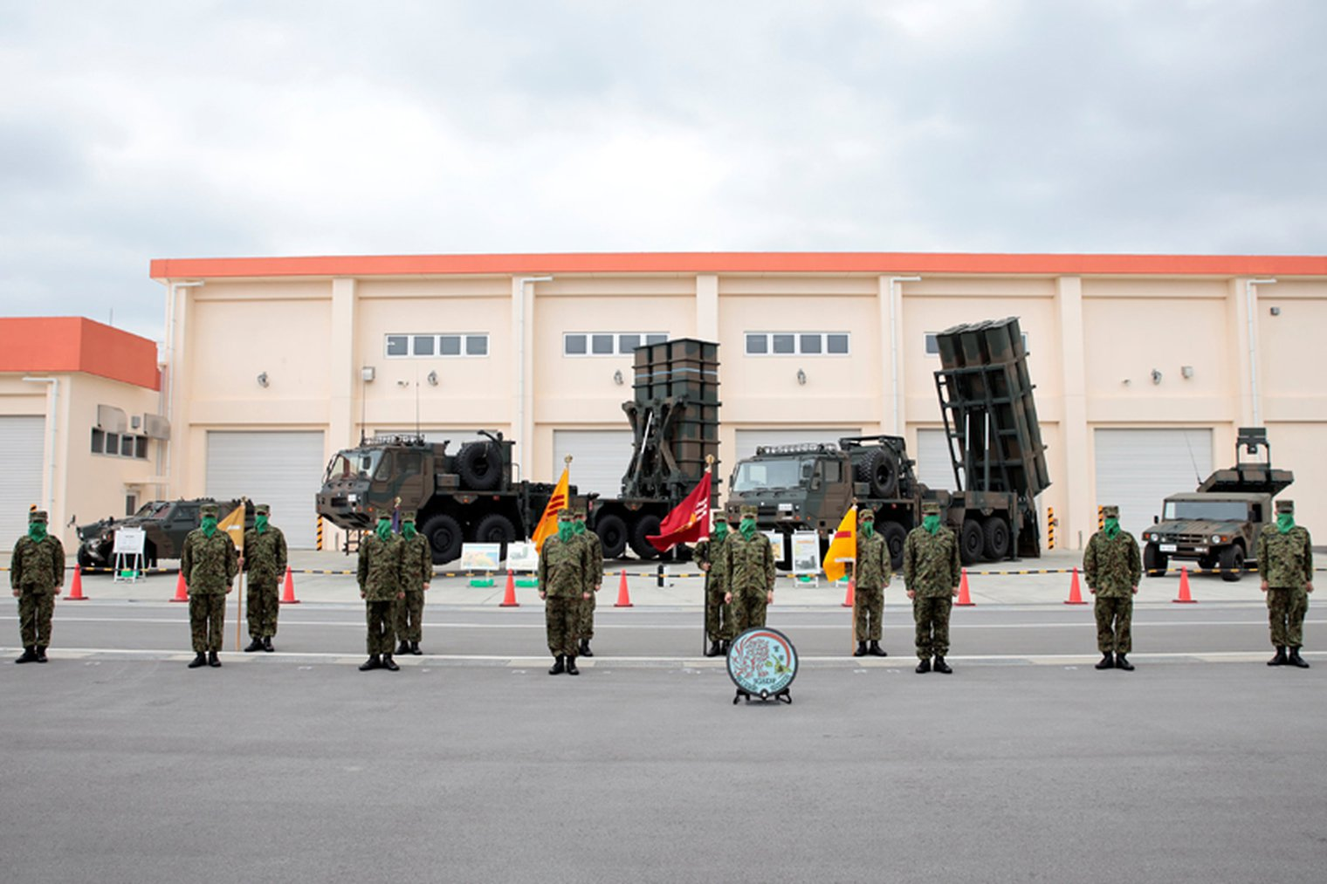
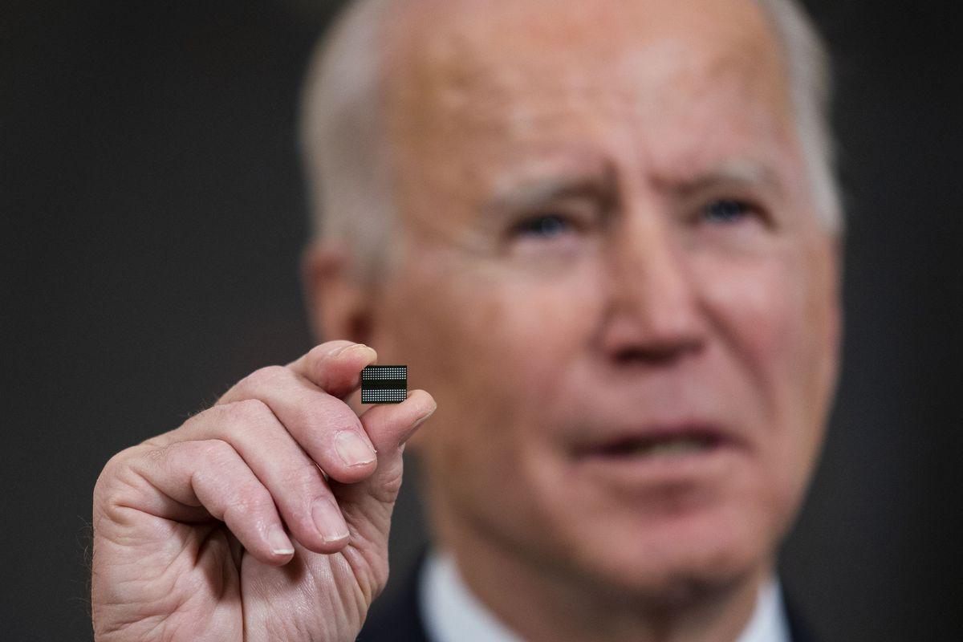
Current stance
„Chips Act“
Trump stance 2025
Increasing mititarization
Rising agression from China
Notes:
USA Chips Act Passed -> ban software, latest chips, USA factories, no machines, skilled personnel
Trump Stance:
• Strategic Ambiguity: Trump avoided firm commitments on Taiwan’s defense, preferring to negotiate terms if needed.
• Financial Contribution: Suggested Taiwan should pay for its defense, likening it to an insurance arrangement.
• Criticism of Taiwan: Claimed Taiwan “stole our chip business” -> New tarrifs dont apply on imported chips.
• Defense Spending: Urged Taiwan to increase defense spending to 10% of its GDP (2.5 - 3%)
• America First Policy: Expected allies, including Taiwan, to take more responsibility for their defense.
• Uncertain Support: Created ambiguity on direct military support, increasing Taiwan’s vulnerability.

Slide 14
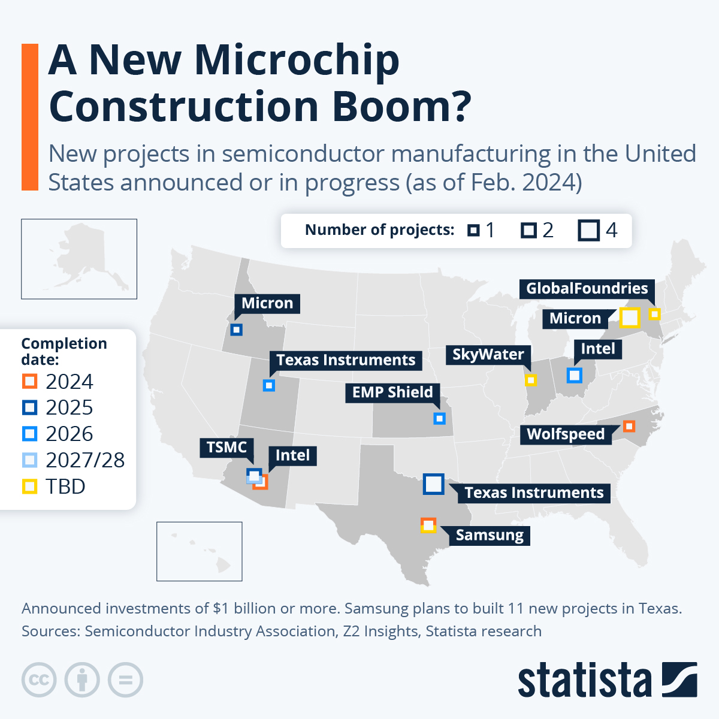
Notes:
Chips act is moving Fabs back to the usa
Also the Know how is moved back through tarrifs and global cooperation

Slide 15
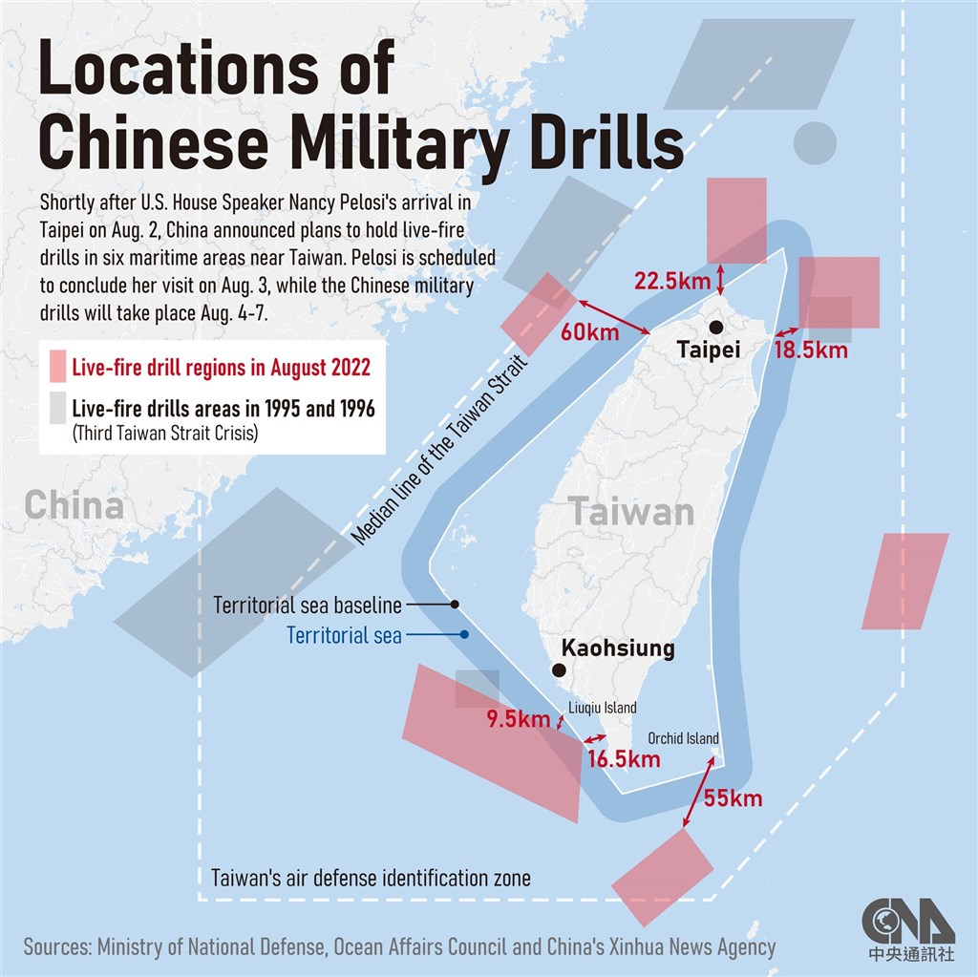
Notes:
Increasing aggression from China1995
First democratic elections Taiwan
2022 Speaker of the House of Representatives USA Visit

Slide 16
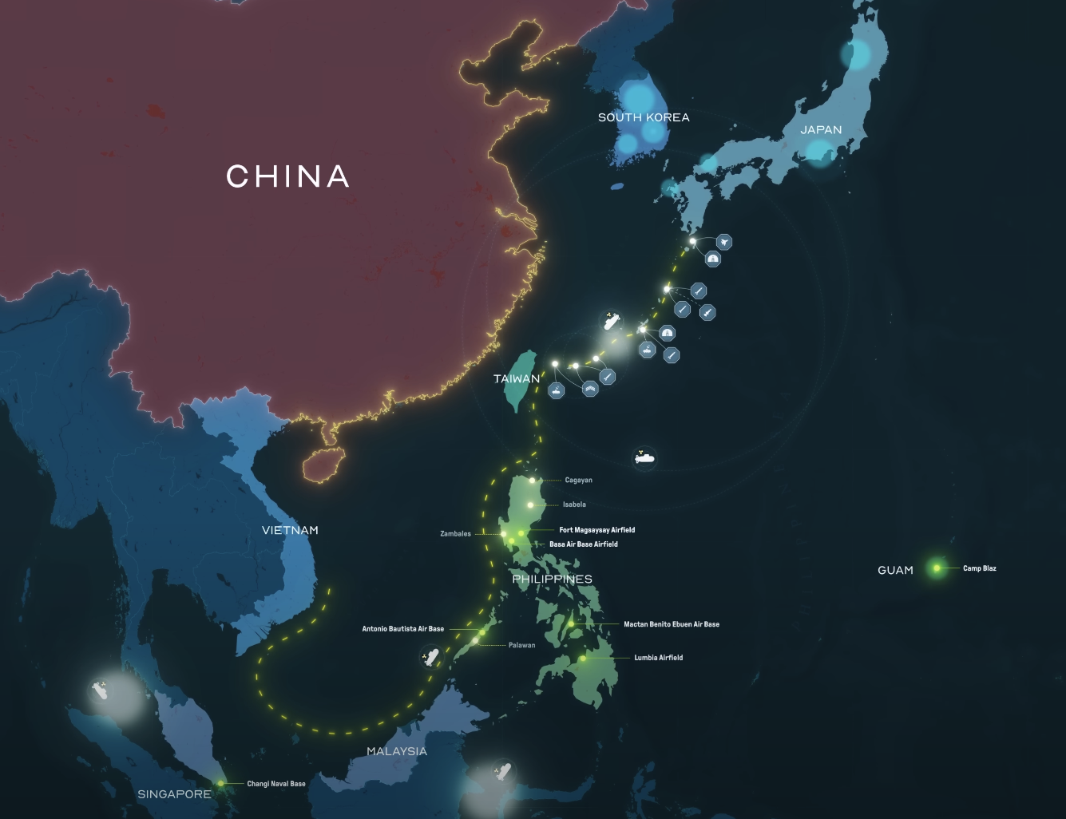
Notes:
Militarization of the region
Dashed yellow line 10 Dash line
Considered Chinese waters by china -> Not agreeing with international sea rights of the un

Slide 17
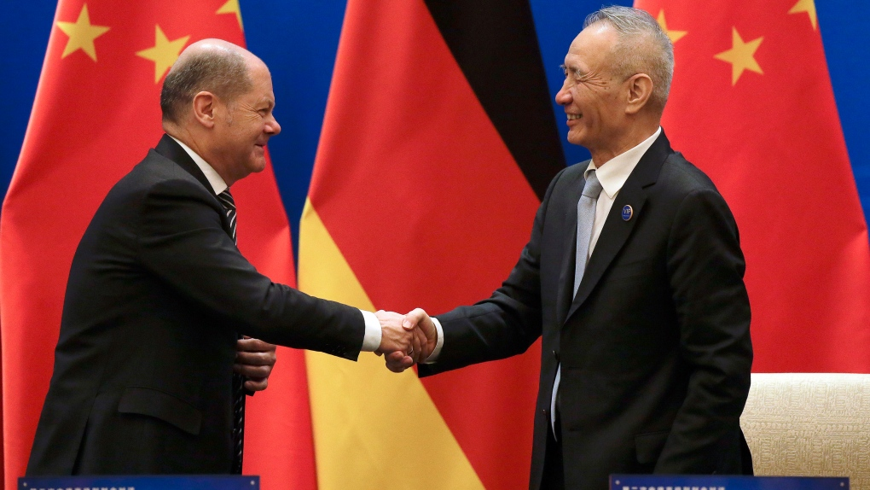
Germany stance
Taiwan recognition
Economic independence
USA NATO
Notes:
Germany does not recognize Taiwan as independent either
At the same time, we are dependent on Taiwan as a microchip producer and they are a democracy
But we cannot recognise them because of our economic dependence on China as a producer/customer
But would have to take action in potential war against China (NATO)

Slide 18
Quellen (Zugriff 29.09.2023 )
https://www.youtube.com/watch?v=k_zz3239DA0&
https://www.bbc.co.uk/history/historic_figures/kilby_and_noyce.shtml
https://fedtechmagazine.com/article/2018/09/how-government-helped-spur-microchip-industry#:~:text=The%20Air%20Force%20and%20NASA,wrote%20in%20a%201988%20paper.
https://airandspace.si.edu/stories/editorial/apollo-guidance-computer-and-first-silicon-chips
https://www.csis.org/analysis/semiconductors-and-national-defense-what-are-stakes
https://www.cnet.com/tech/computing/what-its-like-inside-a-7-billion-intel-fab/
https://mediakron.bc.edu/edges/case-studies-in-the-taiwan-miracle/hsinchu-science-park-a-case-study-in-taiwans-shift-to-tech/from-industry-to-innovation-hsinchu-science-park-tsmc-and-the-development-of-taiwans-tech-sector/opening-hsinchu-science-park
https://www.tsmc.com/english/aboutTSMC/company_profile#:~:text=TSMC's%20foundry%20business%20model%20has,535%20different%20customers%20in%202021.
https://www.reuters.com/breakingviews/taiwan-digs-trenches-battle-chip-talent-2022-08-17/
Notes:
These are my sources

Slide 19
Questions?
Notes:
Danke fürs Zuhören

Slide 20
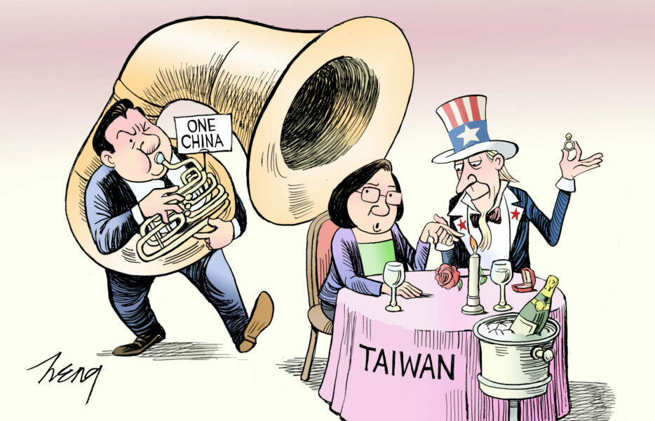
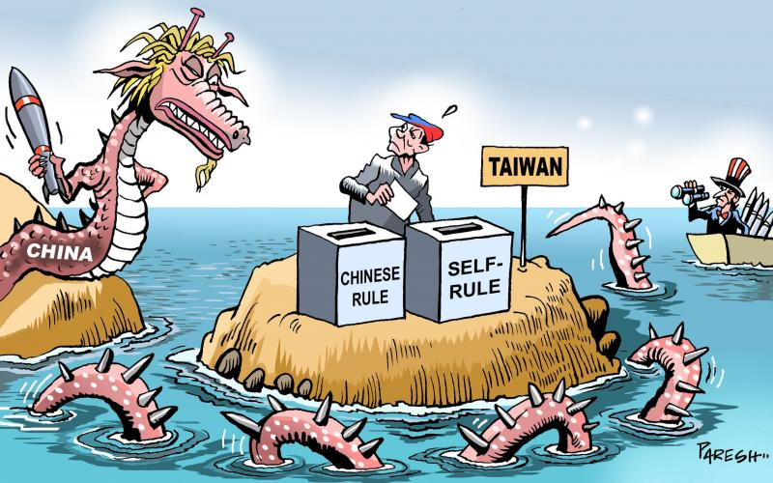
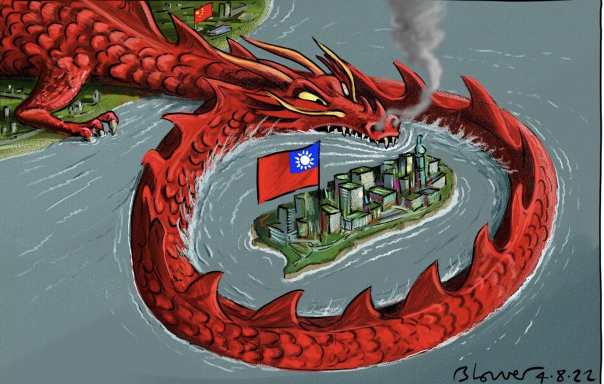
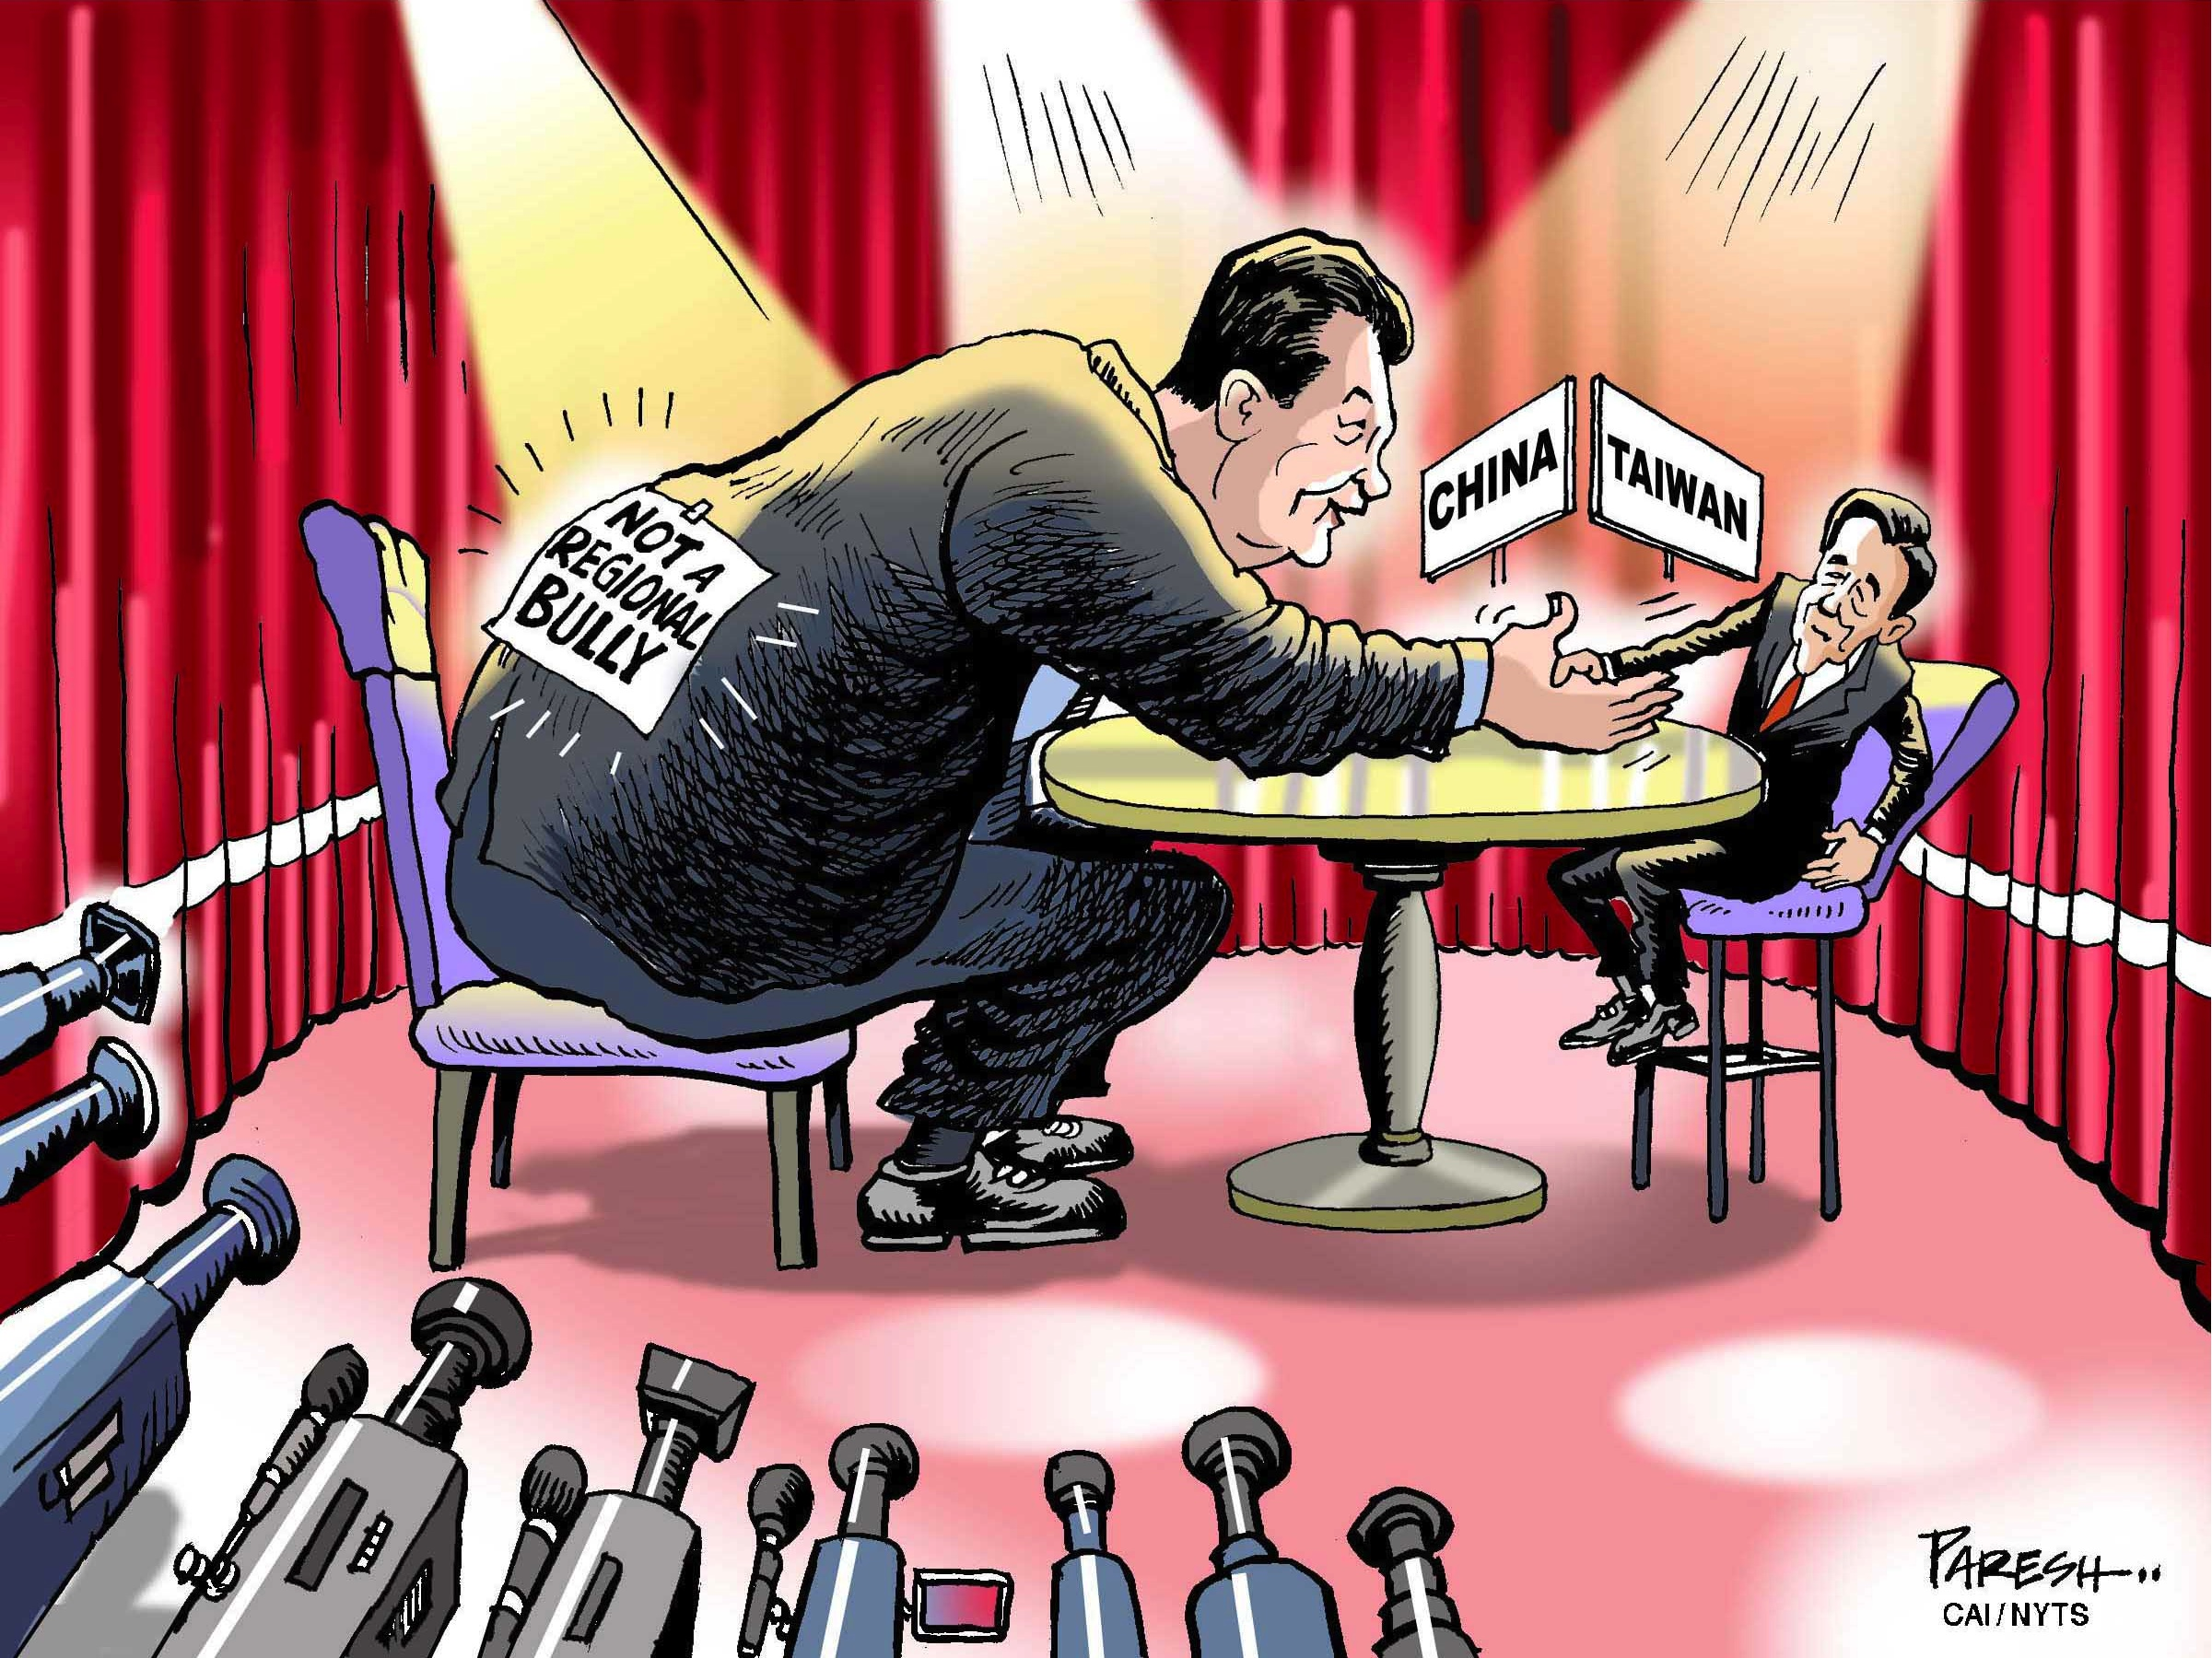
Notes:
Karikaturen mitgebracht
Fragen, Meinunge, Feedback?

